Slide 1

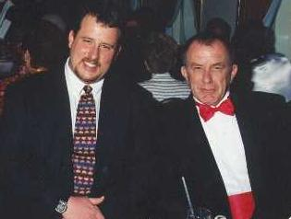
Exposure CS 2021
for CS1
Chapter 8 Section 1-5 Slides
Repetition Control Structures
& Using Them with Turtle Graphics
PowerPoint Presentation
created by:
Mr. John L. M. Schram
and Mr. Leon Schram
Authors of Exposure
Computer Science

Slide 2
Section 8.1
Introduction

Slide 3


Program Flow Review
Program Flow follows the exact sequence of listed program statements, unless directed otherwise by a Python control structure.

Slide 4

Repetition Review
Program Statement
Program Statement
Program Statement
True
Condition
False
Program Statement

Slide 5
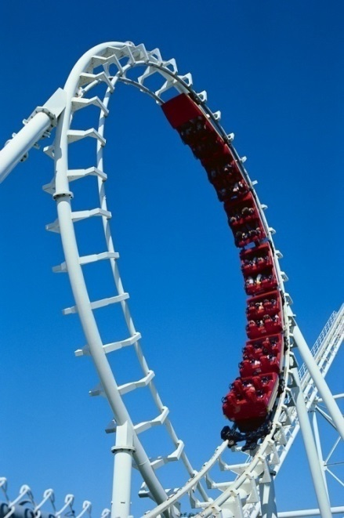
Section 8.2
Fixed
Repetition

Slide 6
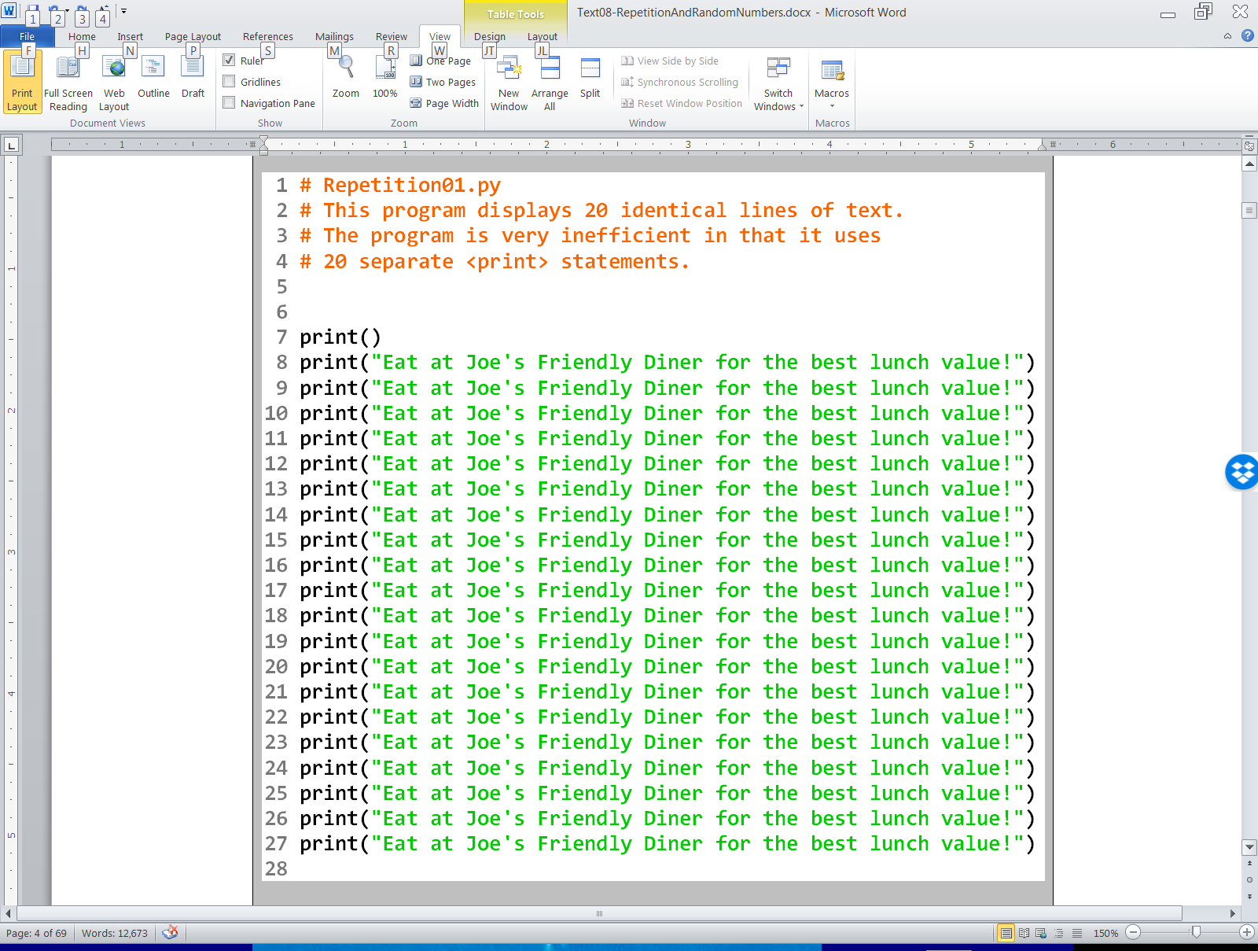

Slide 7
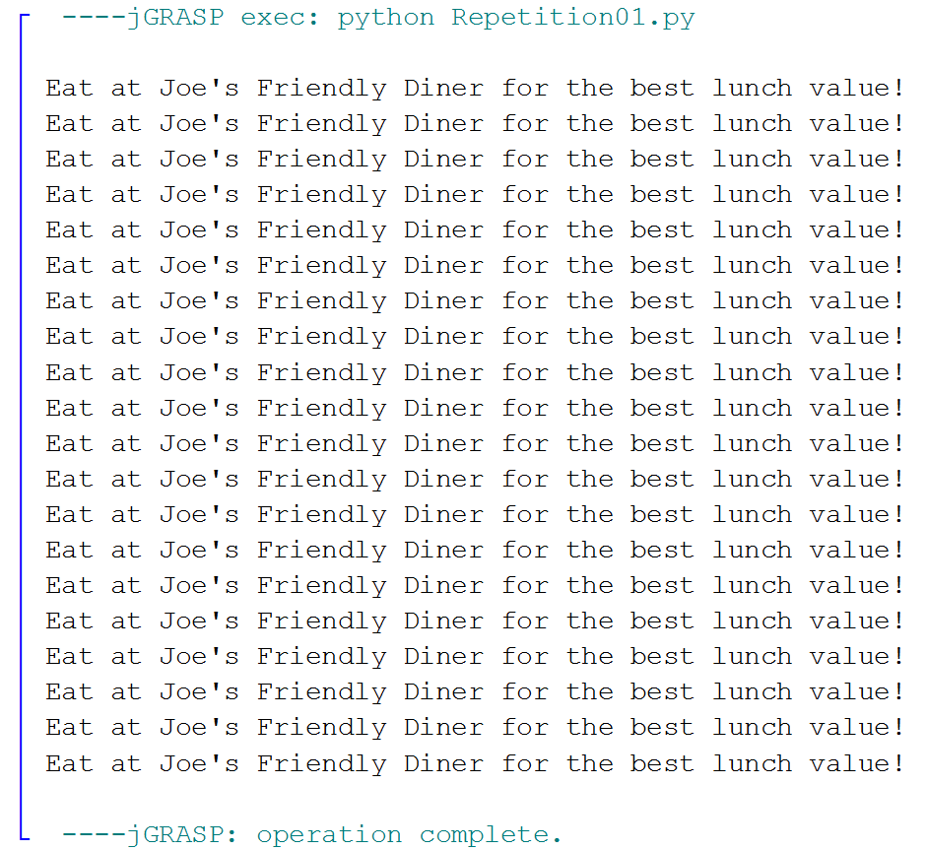

Slide 8
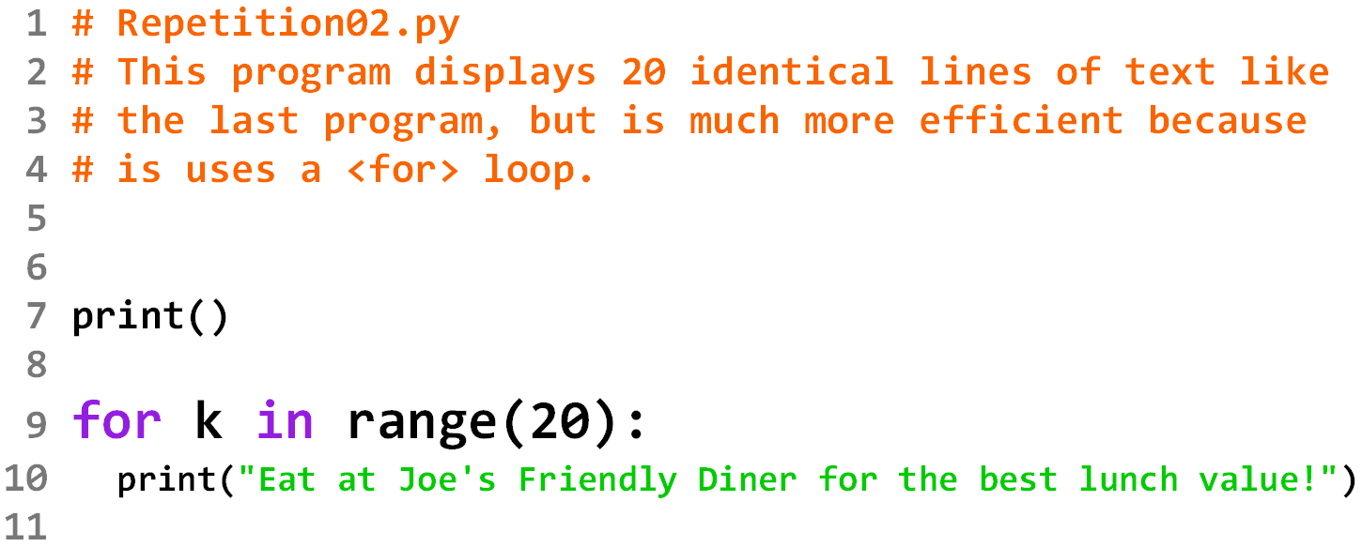
The range value indicates how many times the for loop will repeat.
k is the loop counter or LCV (Loop Control Variable).
It is considered “OK” to use a single letter variable for a loop counter.
This is one of the very few times that it is considered “OK” to use a single letter variable.

Slide 9
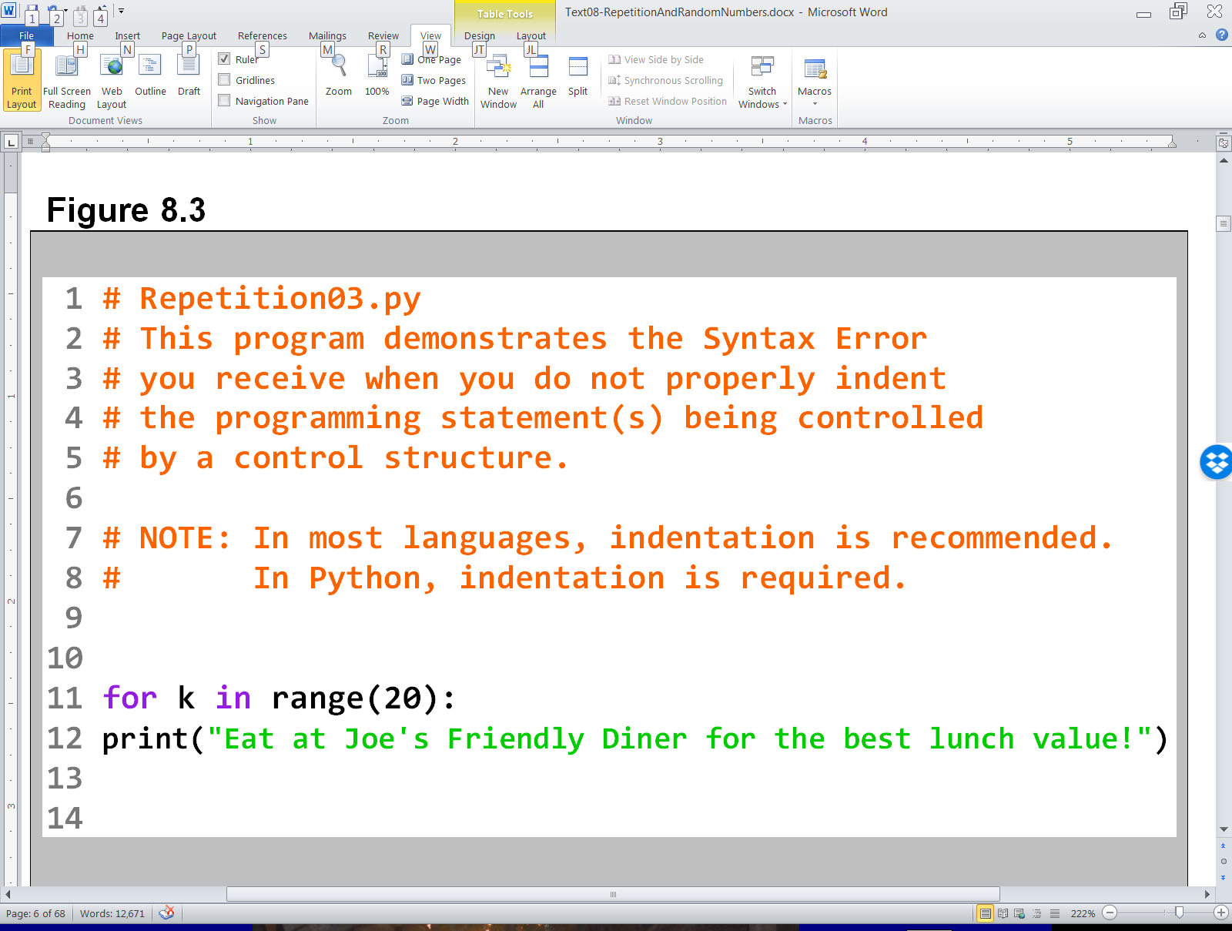
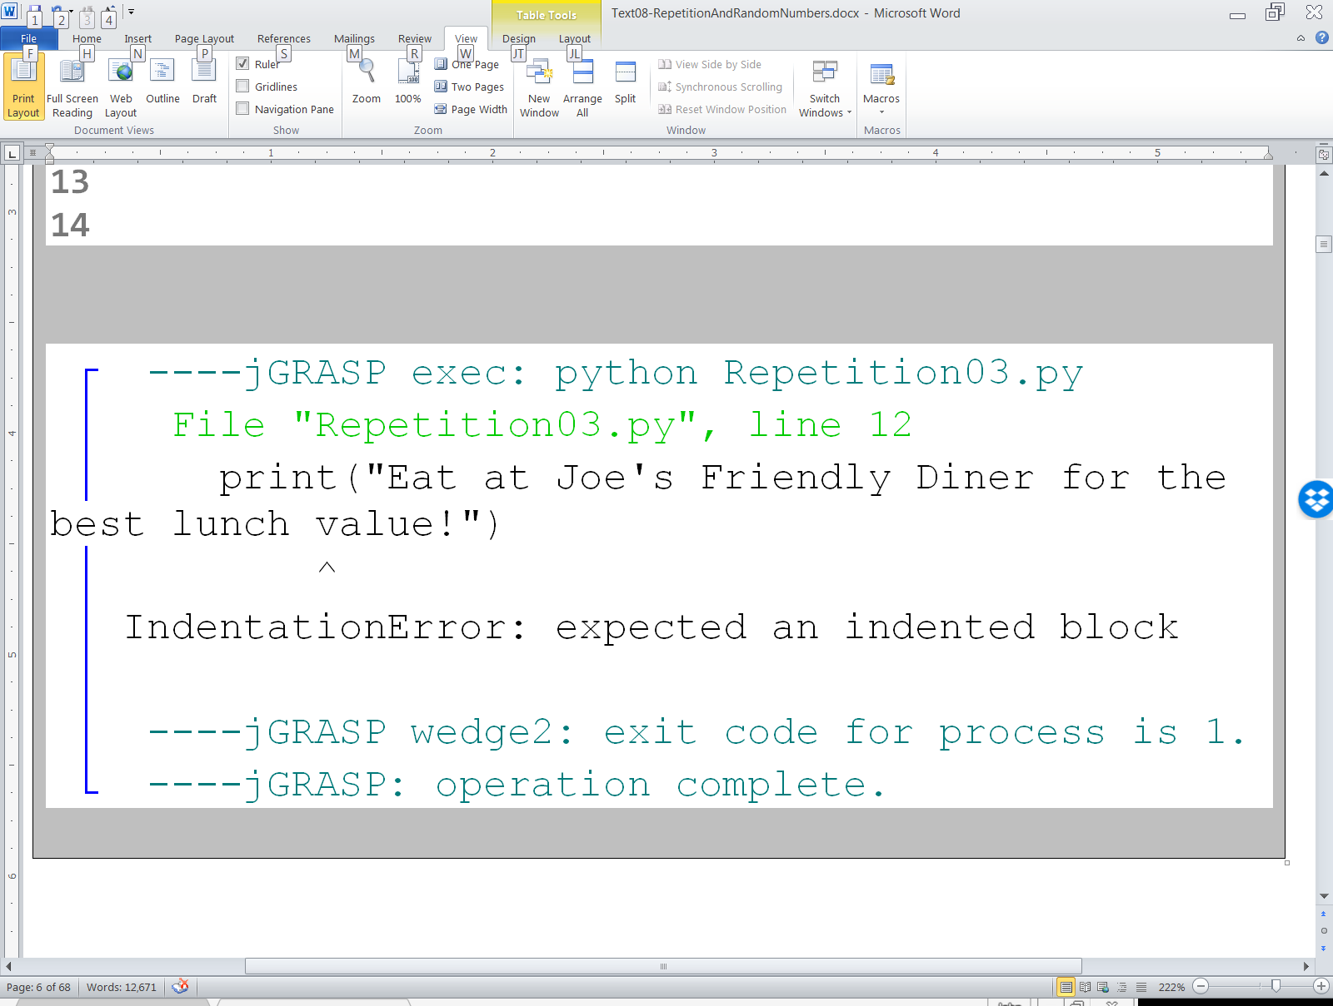

Slide 10
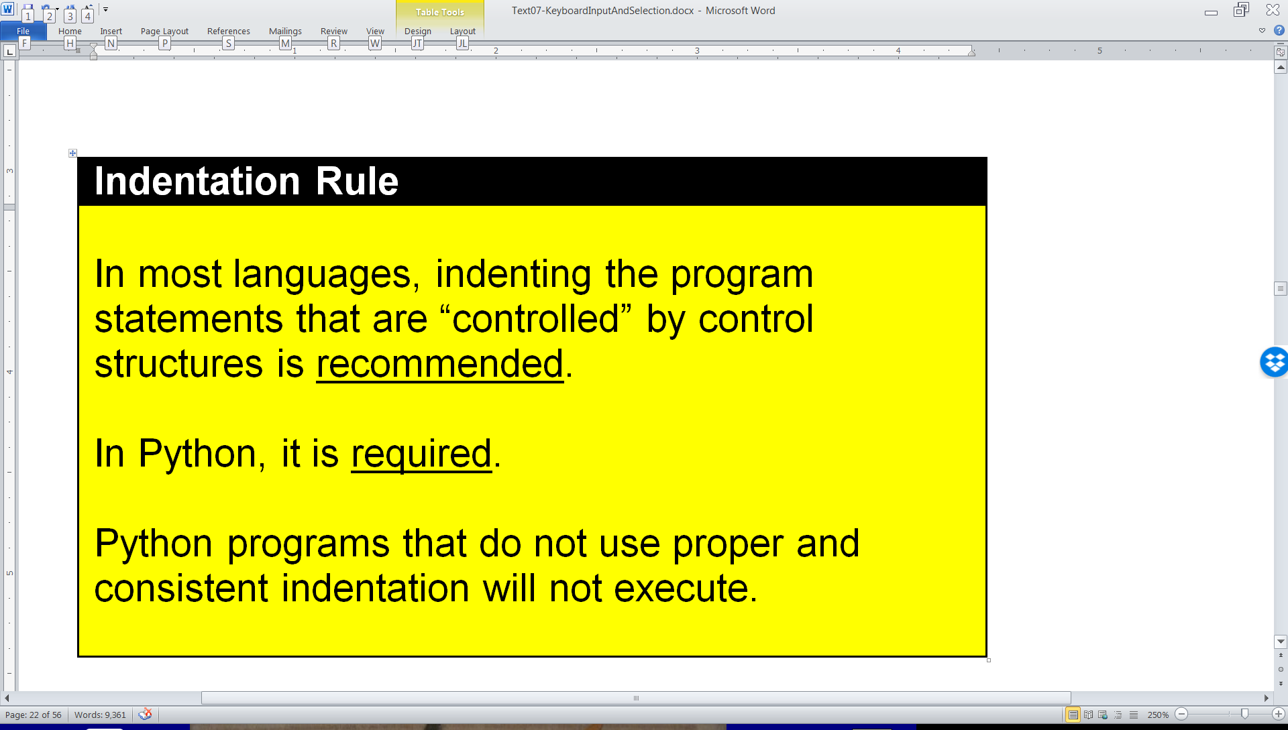

Indentation Rule Review:

Slide 11
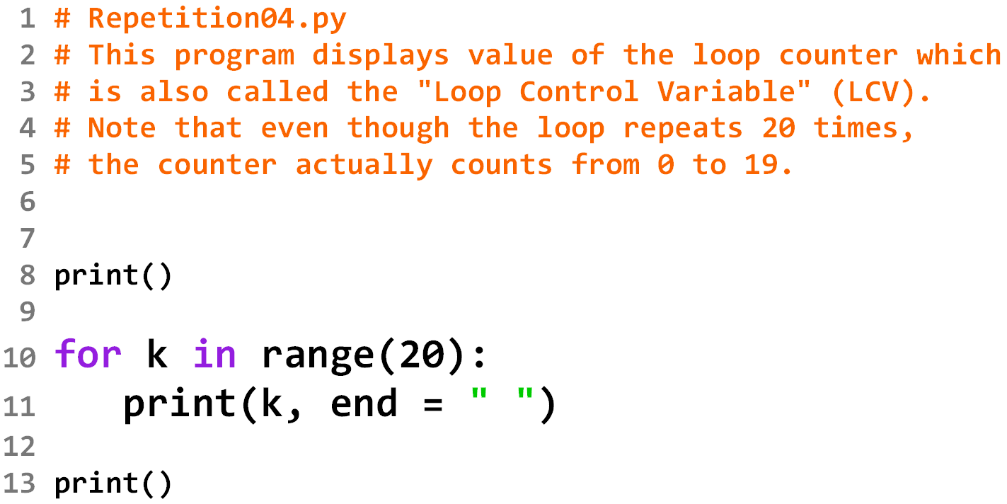
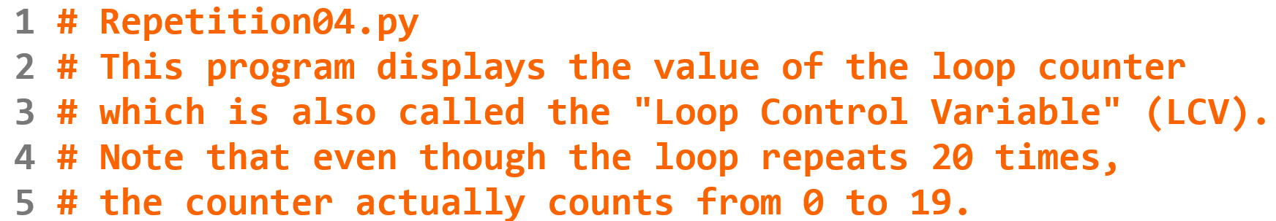

Slide 12
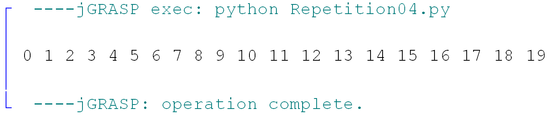

Slide 13
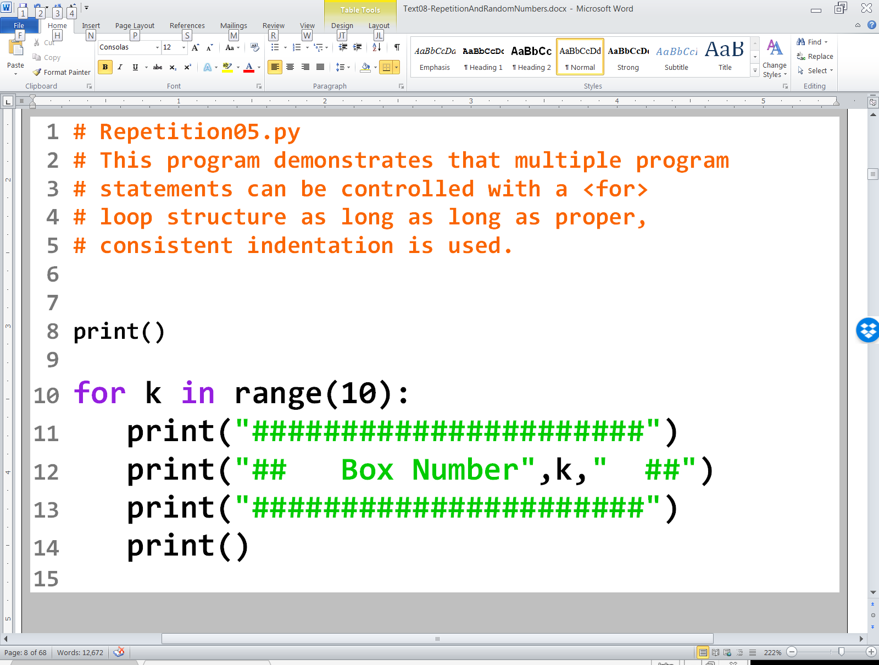

Slide 14
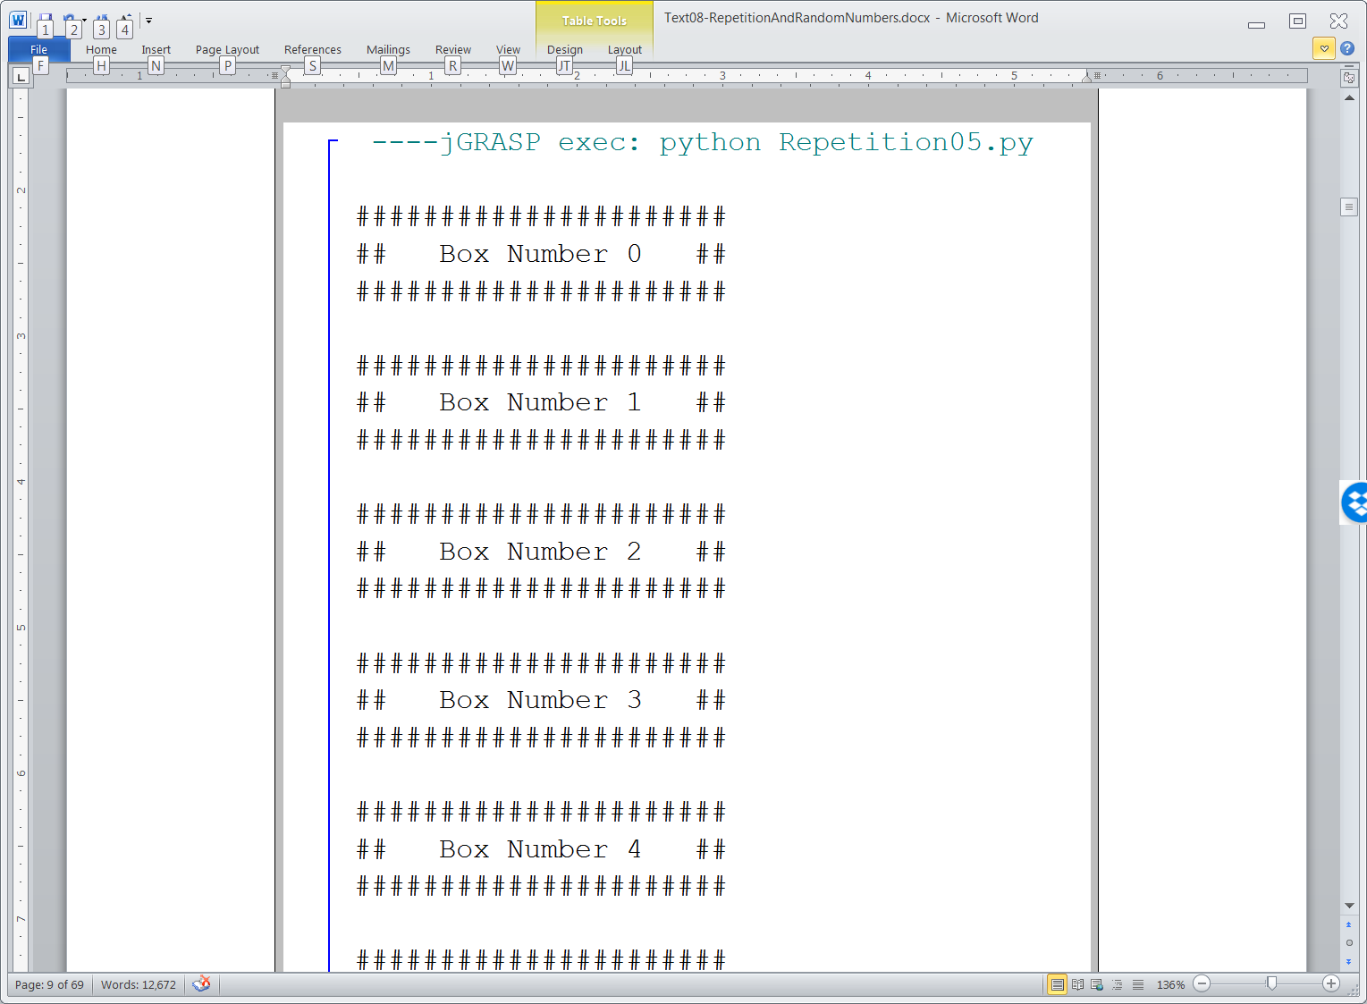
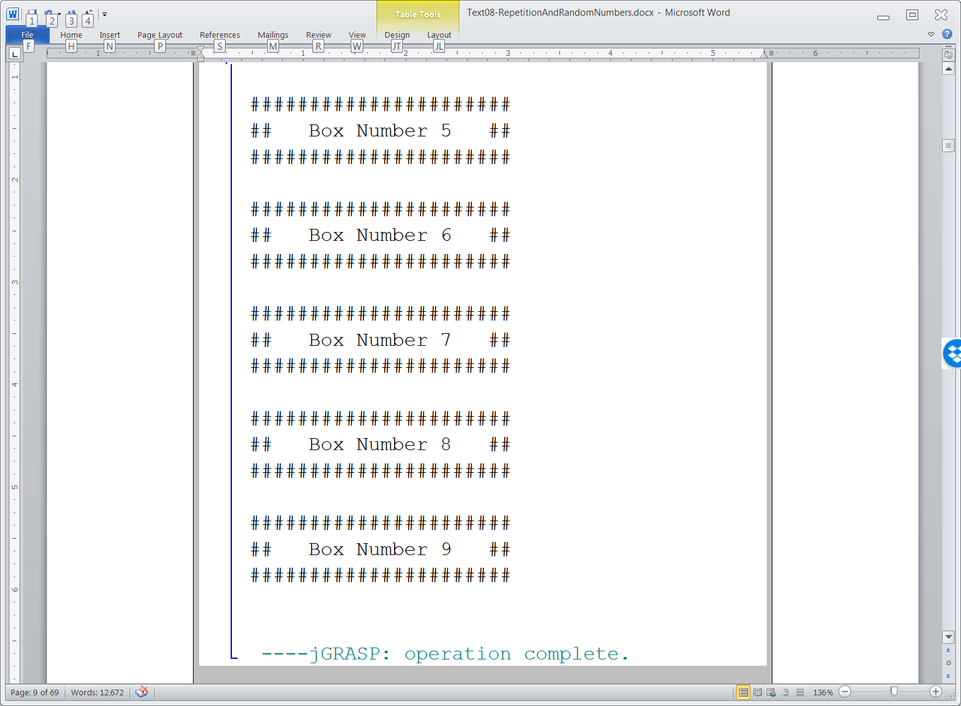

Slide 15
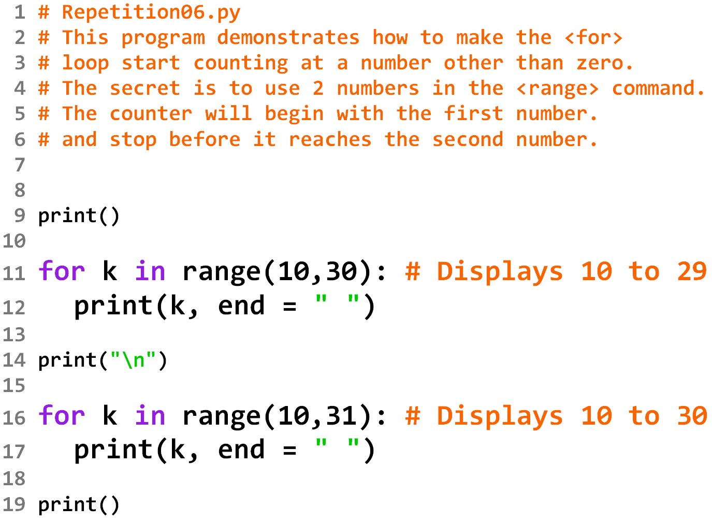

Slide 16
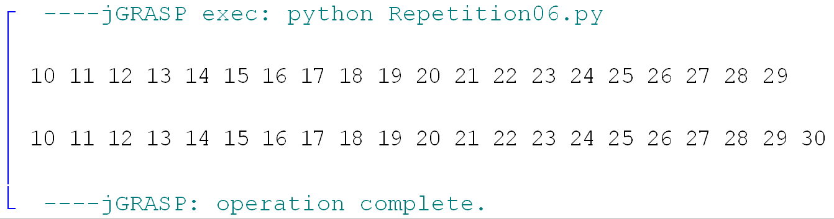

Slide 17
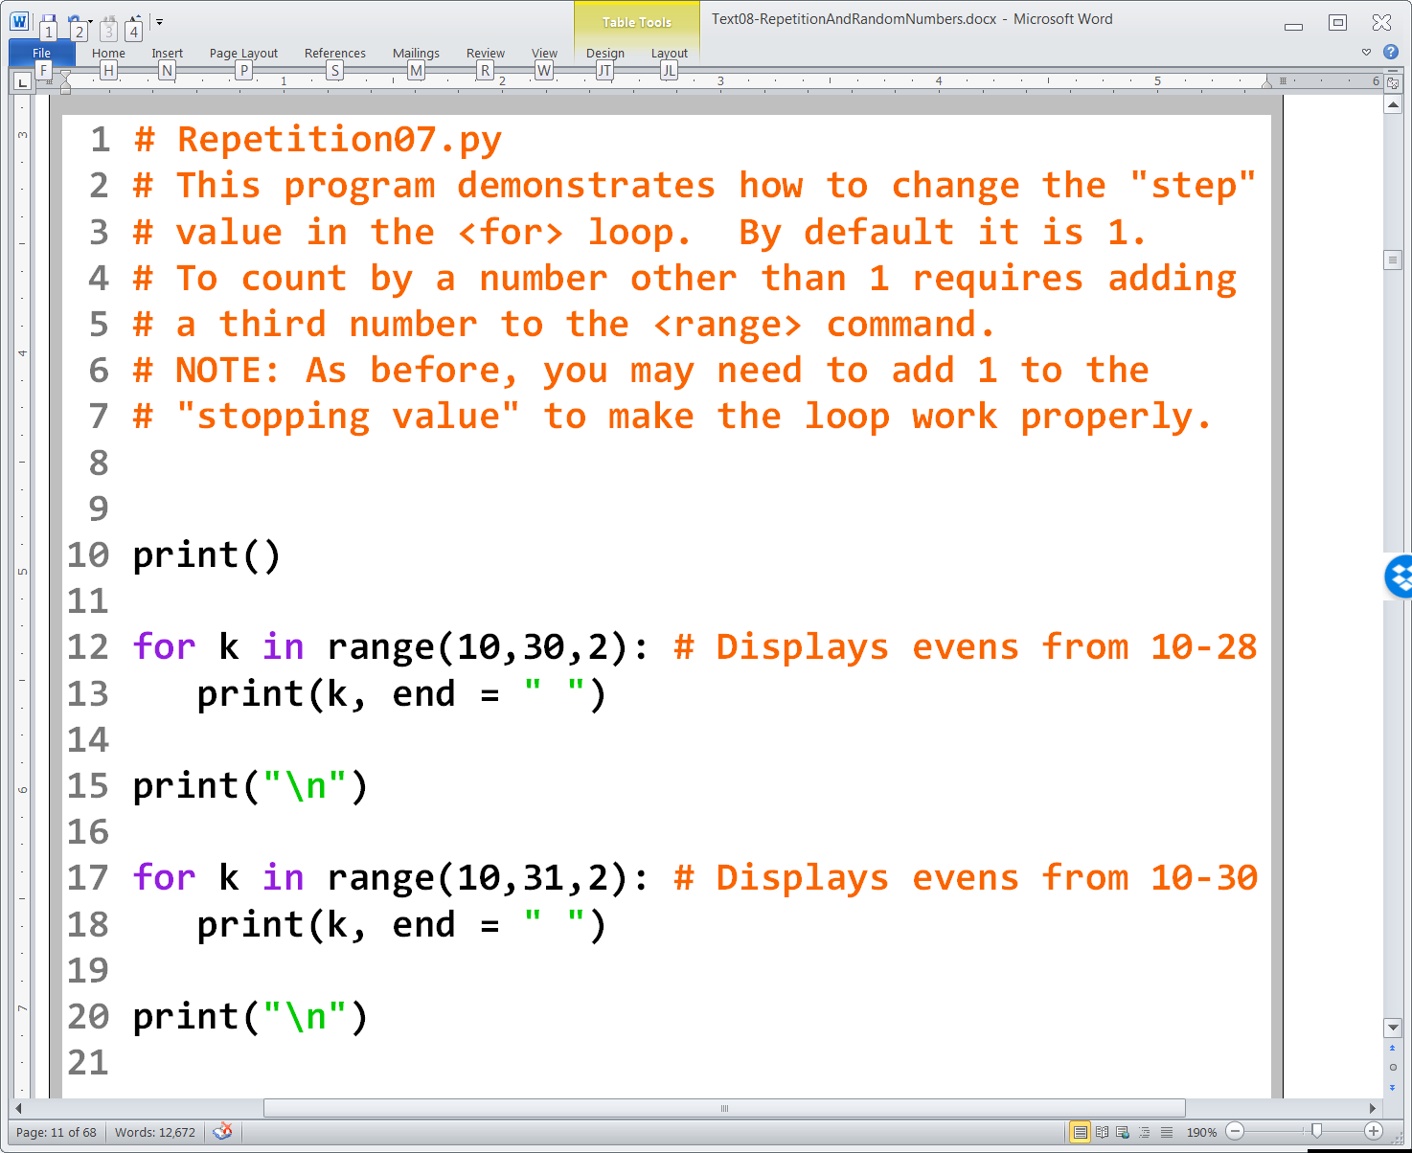

Slide 18
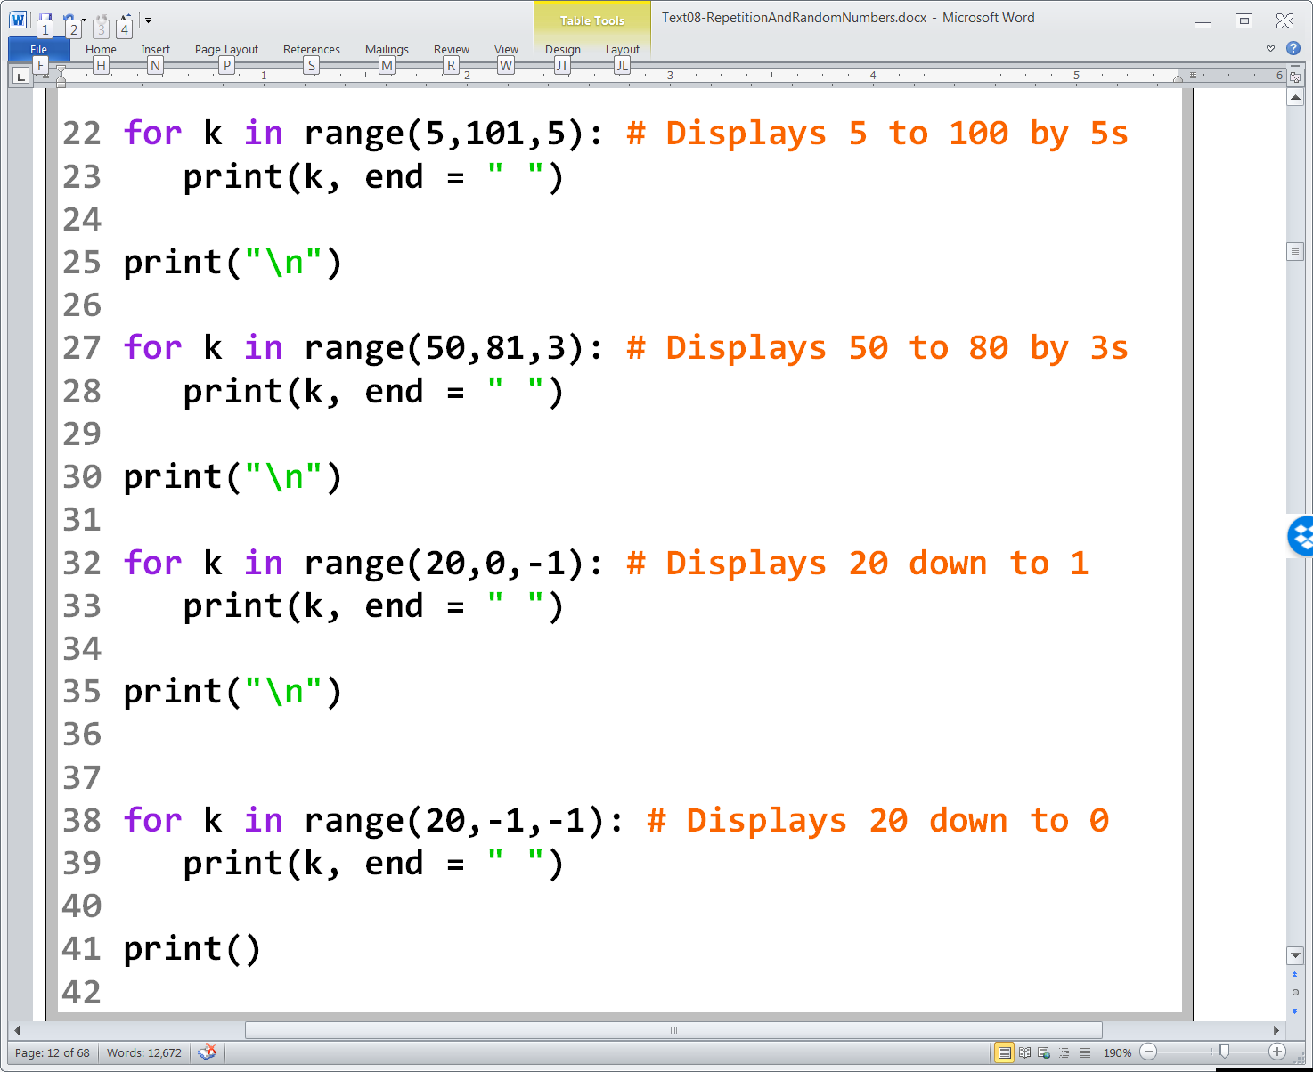

Slide 19
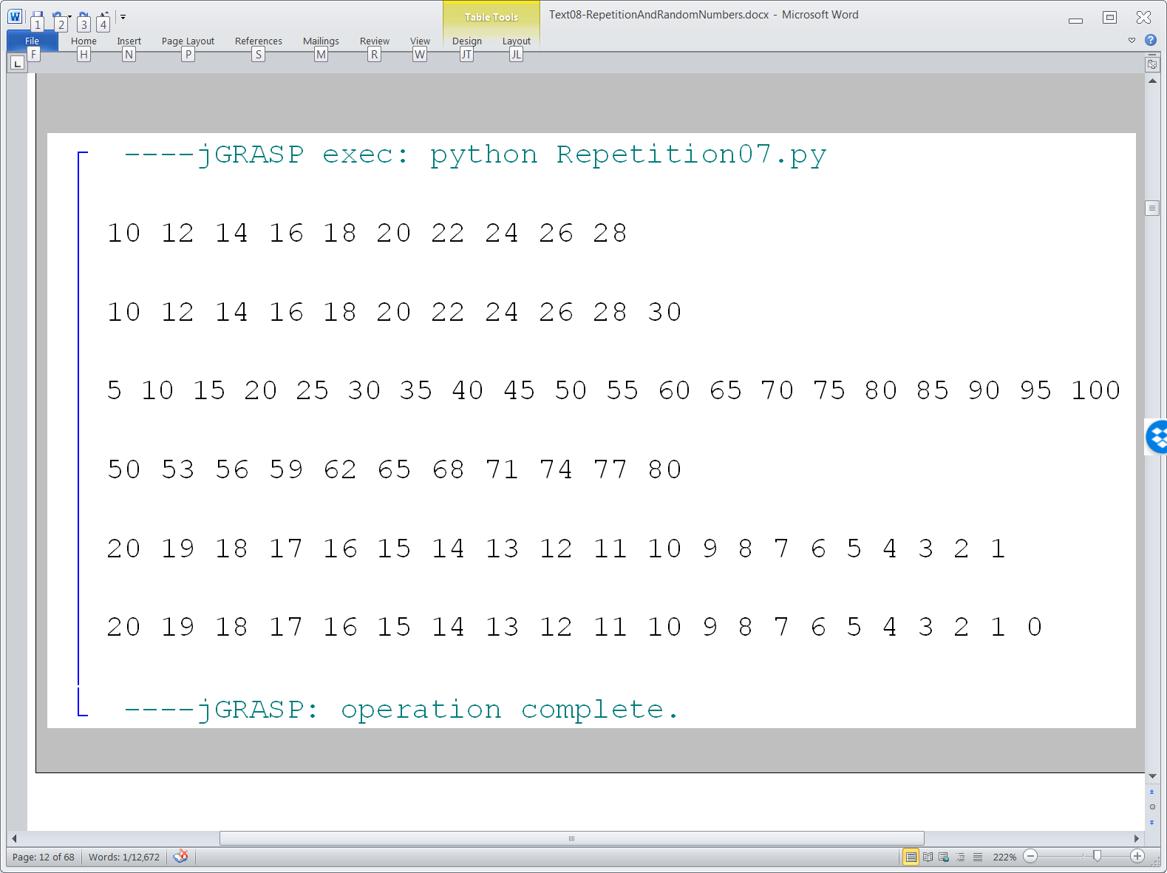

Slide 20
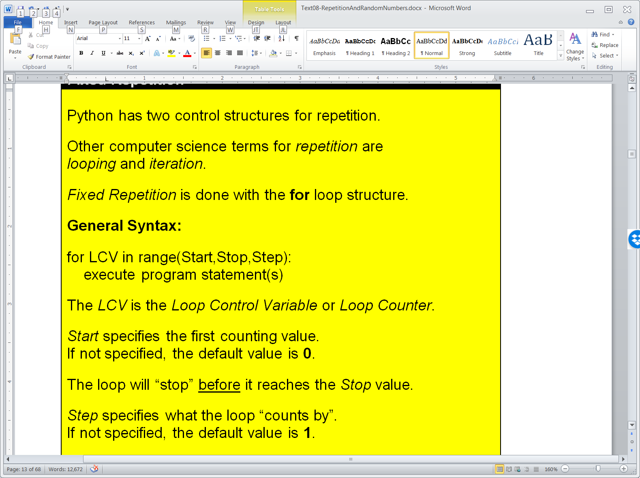
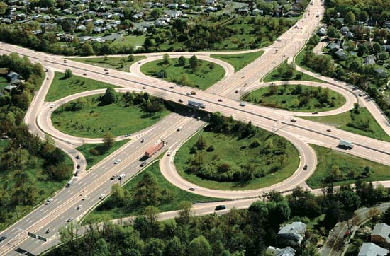
Fixed Repetition

Slide 21
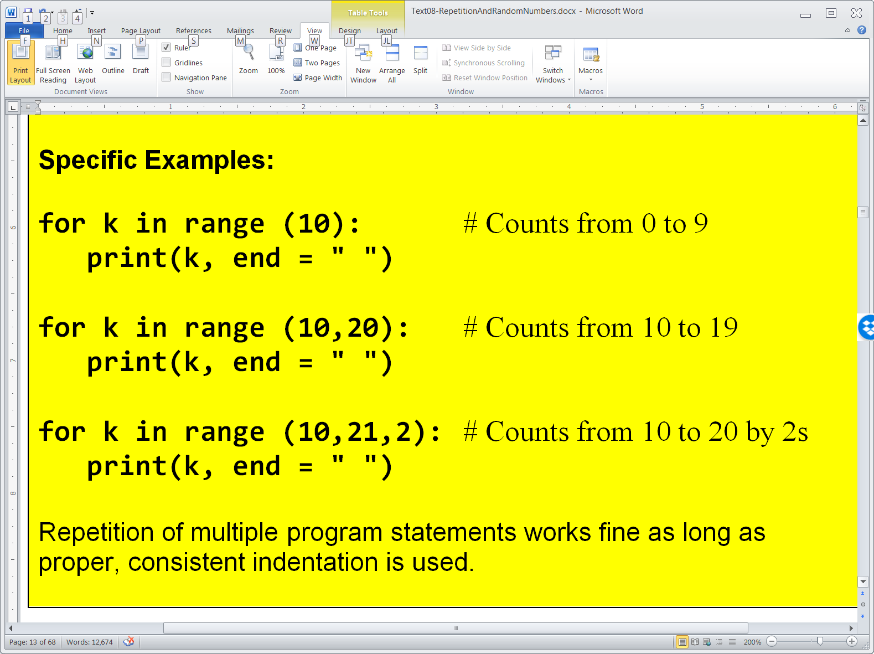
Fixed Repetition (continued)

Slide 22

Section 8.3
Conditional
Repetition

Slide 23
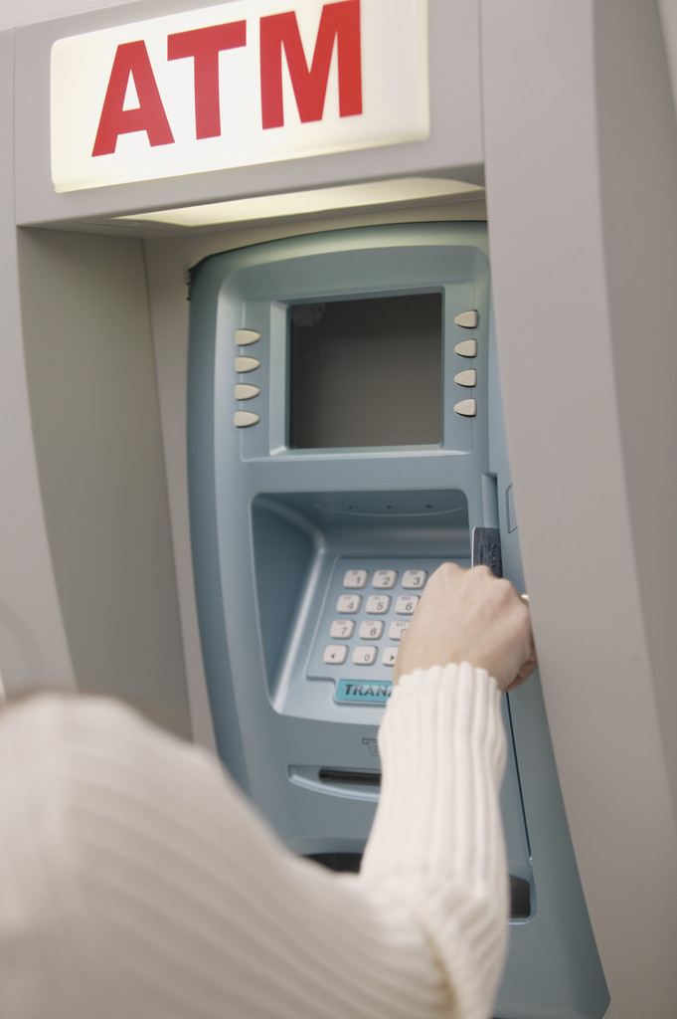

Conditional Repetition Real Life Examples

Slide 24
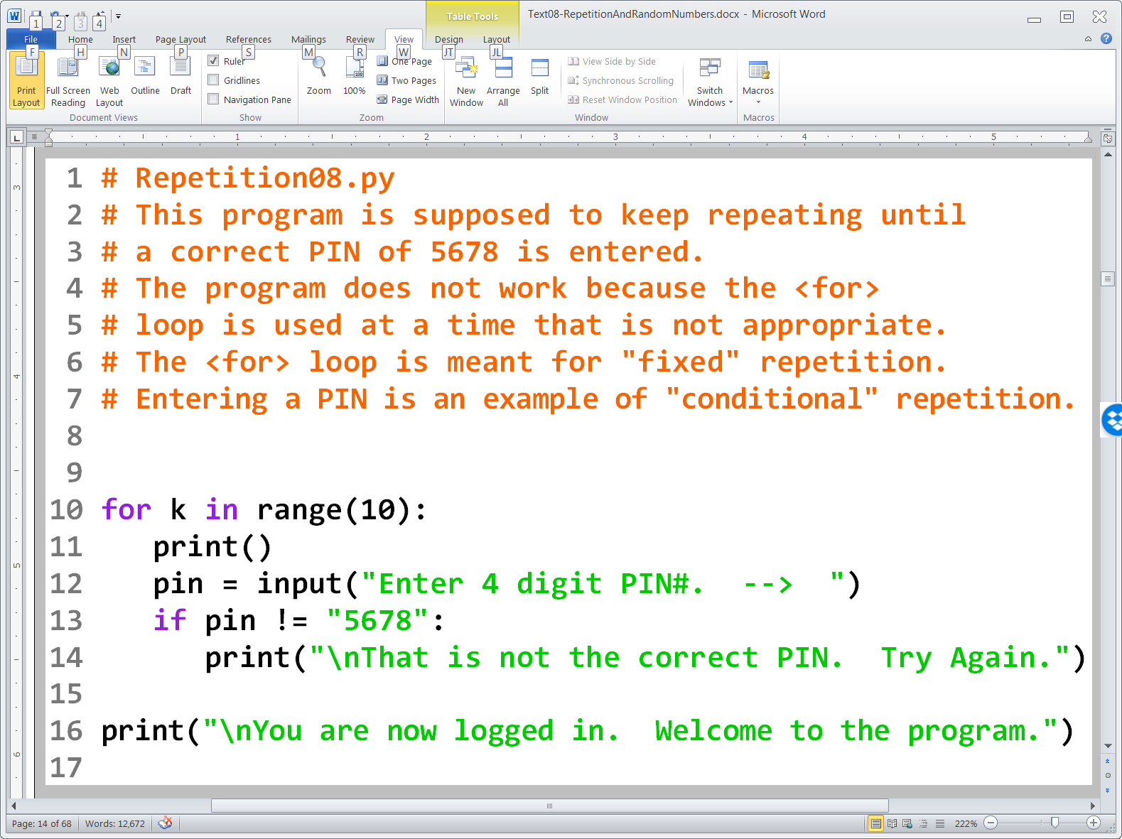

Slide 25
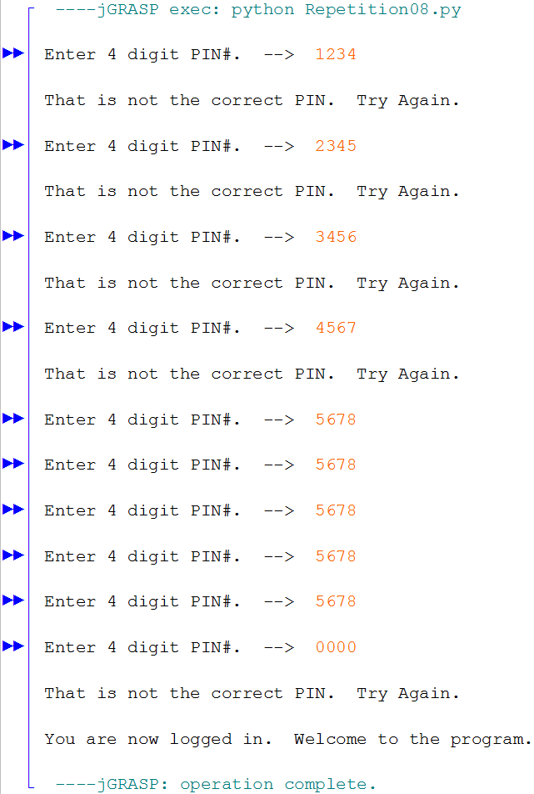

Slide 26
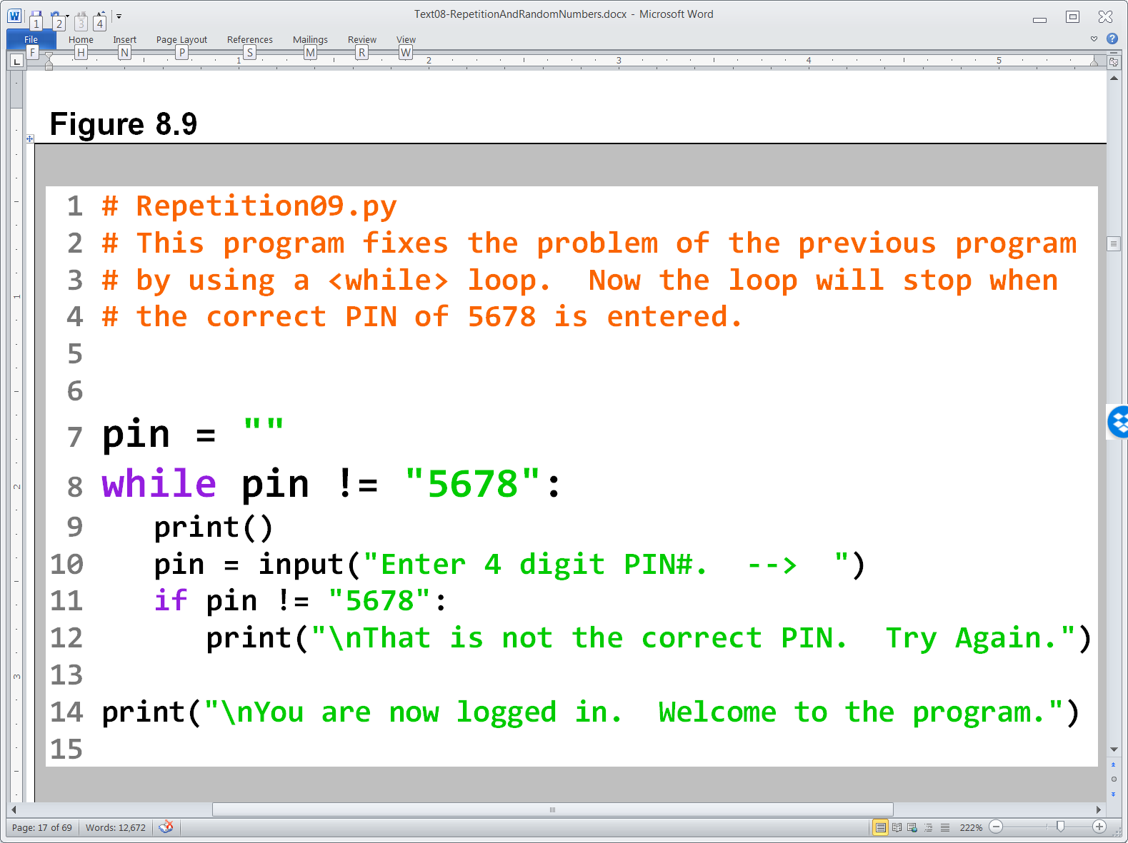

Slide 27
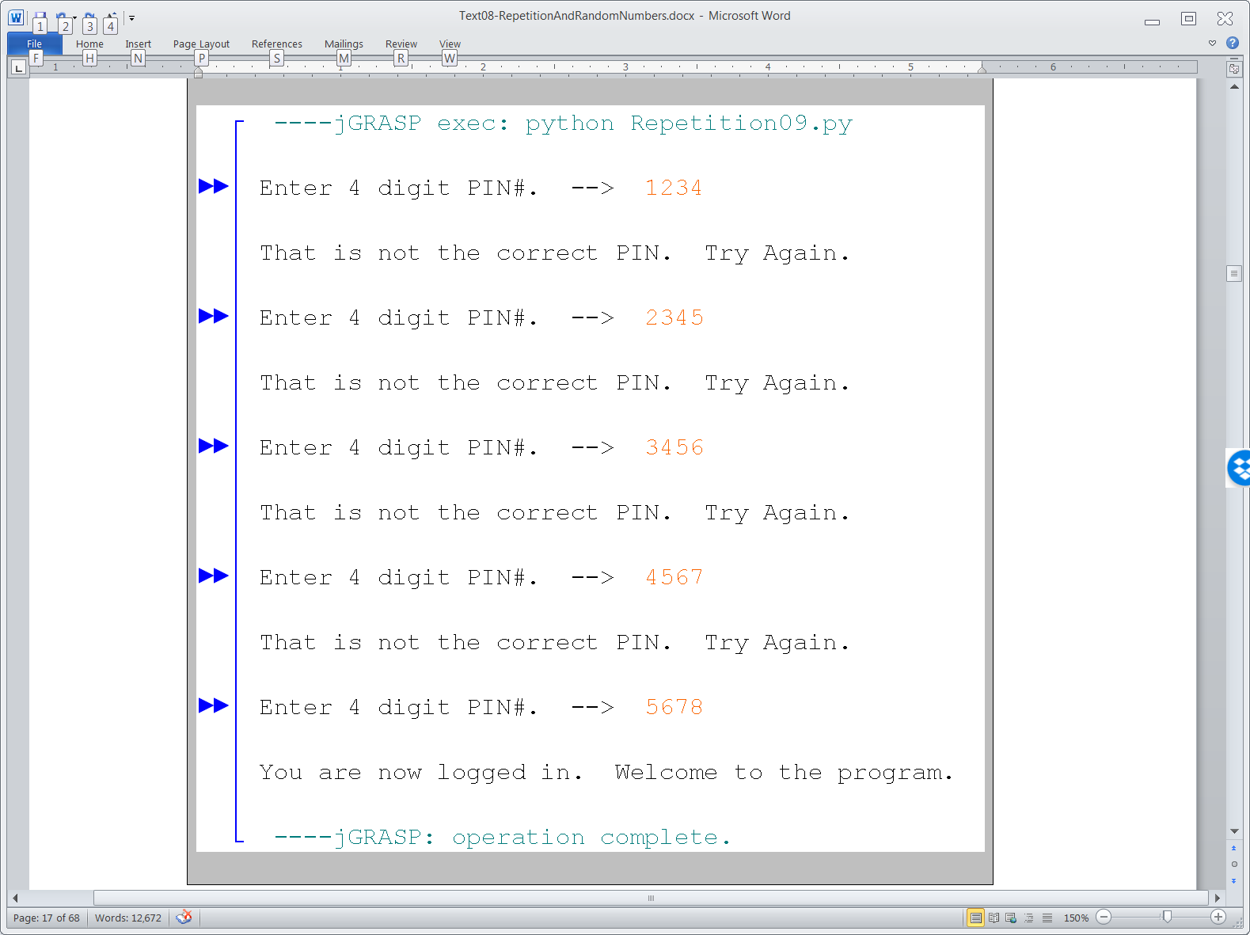

Slide 28
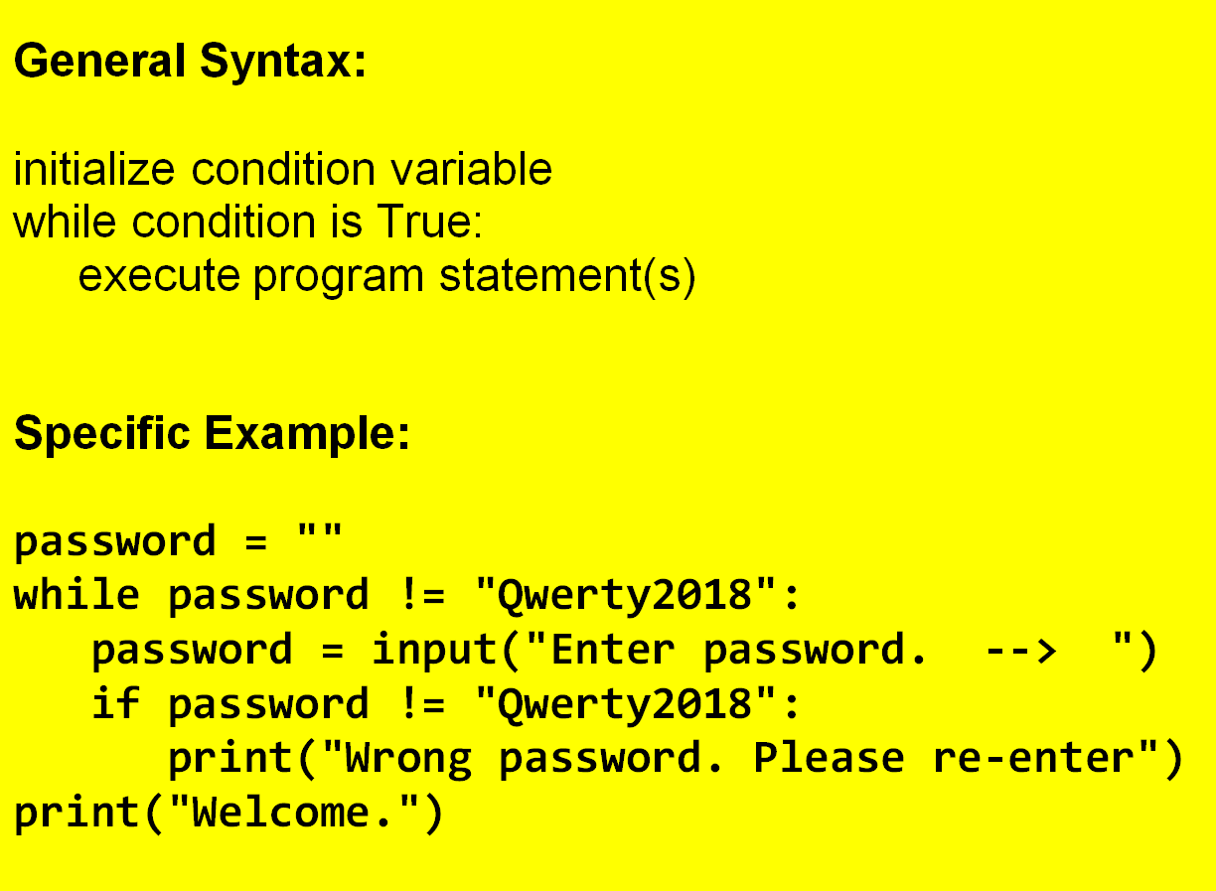
Conditional Repetition

Slide 29
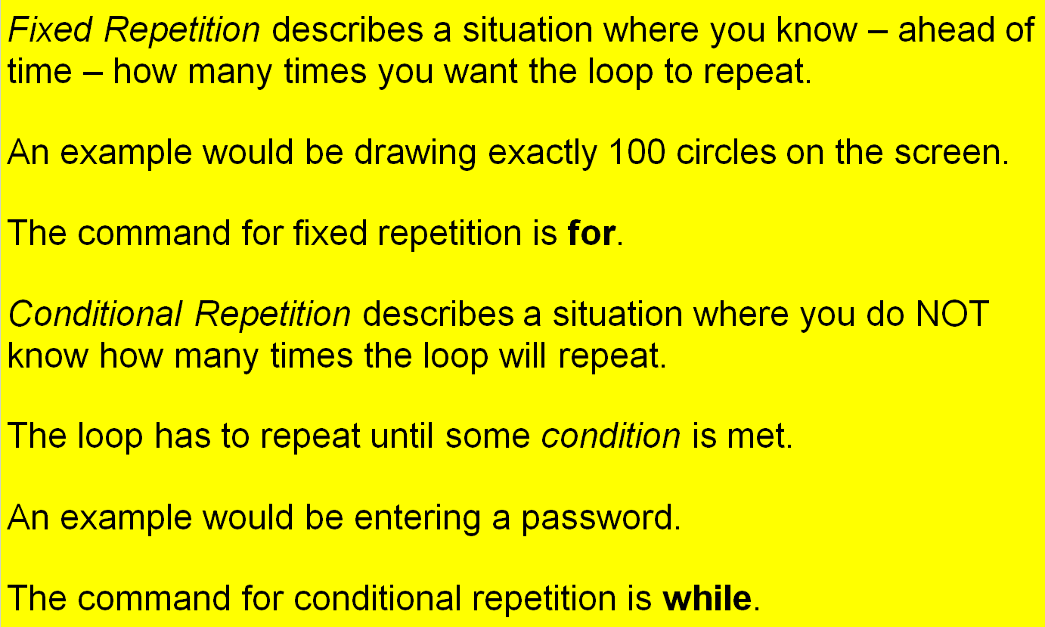
Fixed Repetition vs. Conditional Repetition

Slide 30

Section 8.4
Nested
Control
Structures

Slide 31
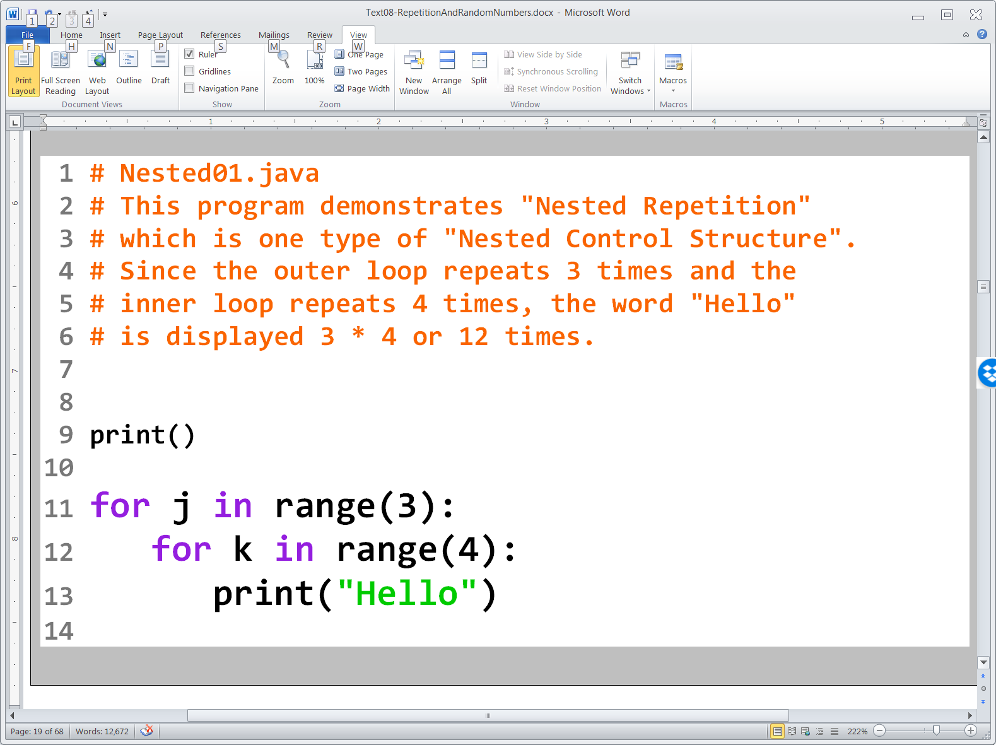

Slide 32
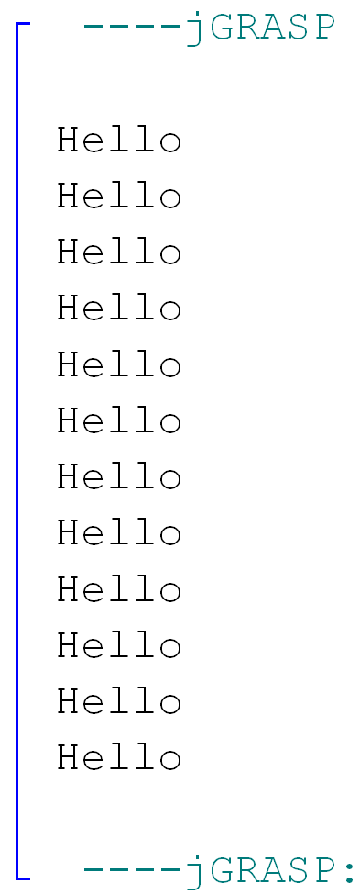

Slide 33
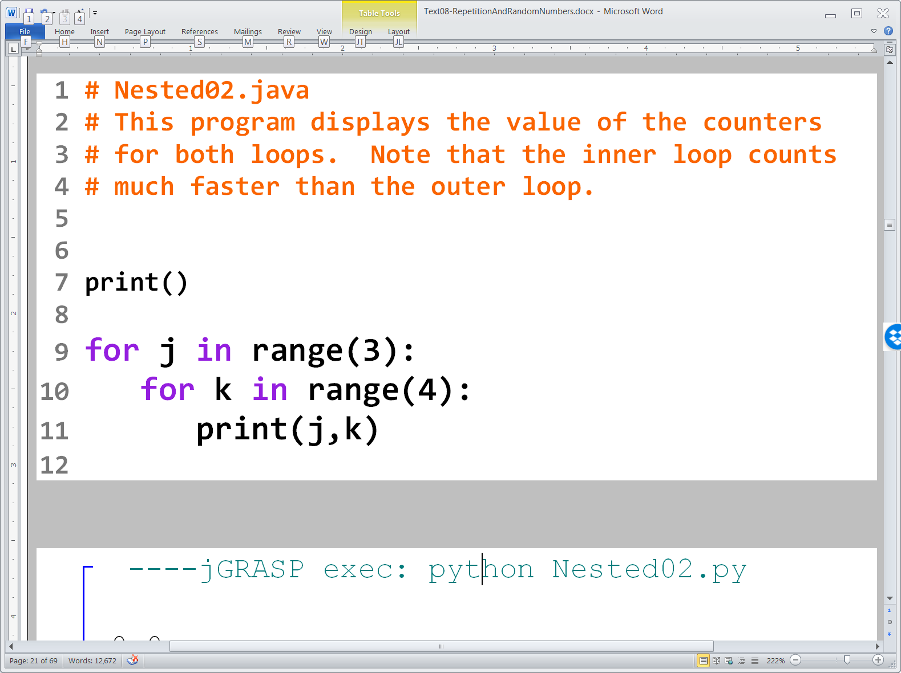

Slide 34
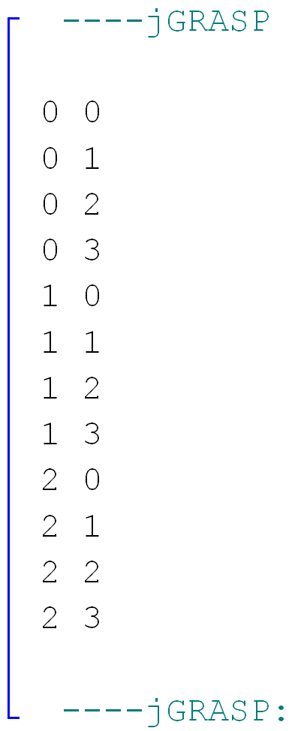

Slide 35
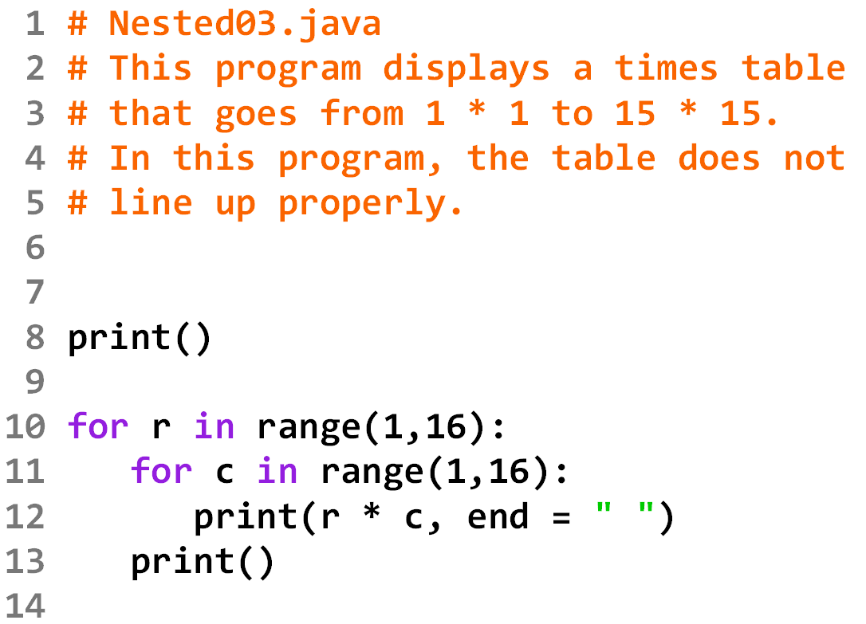

Slide 36
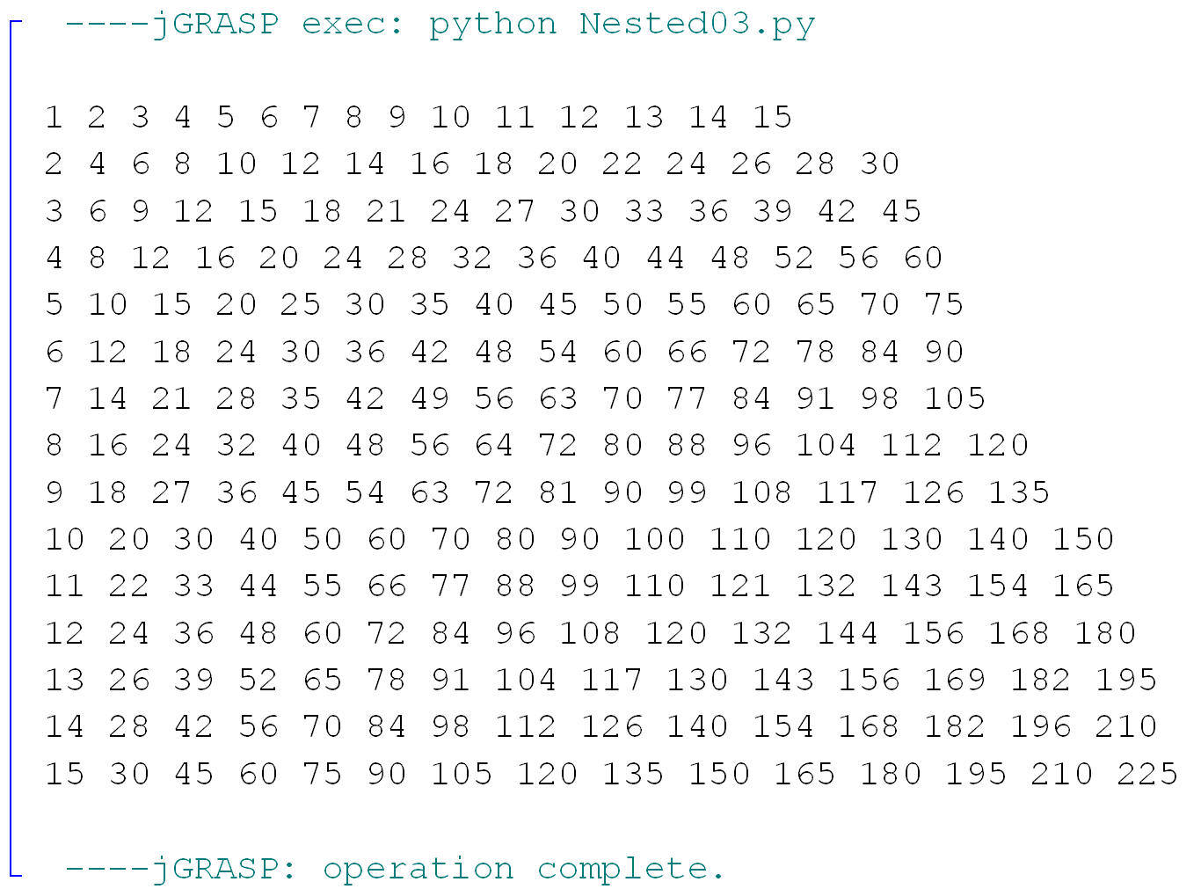

Slide 37
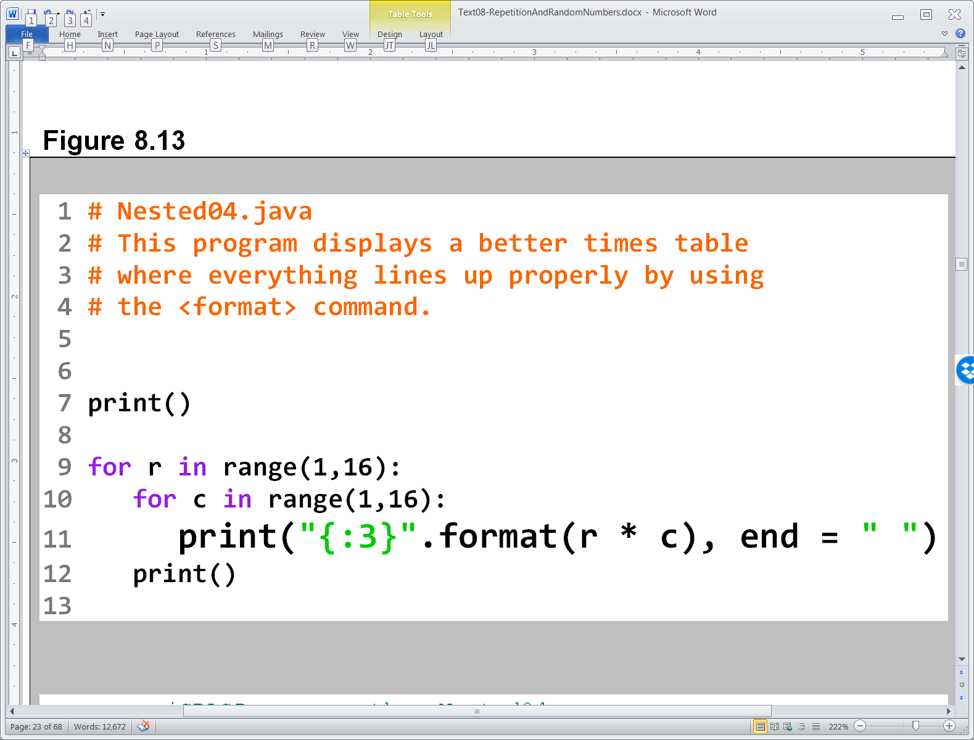

Slide 38
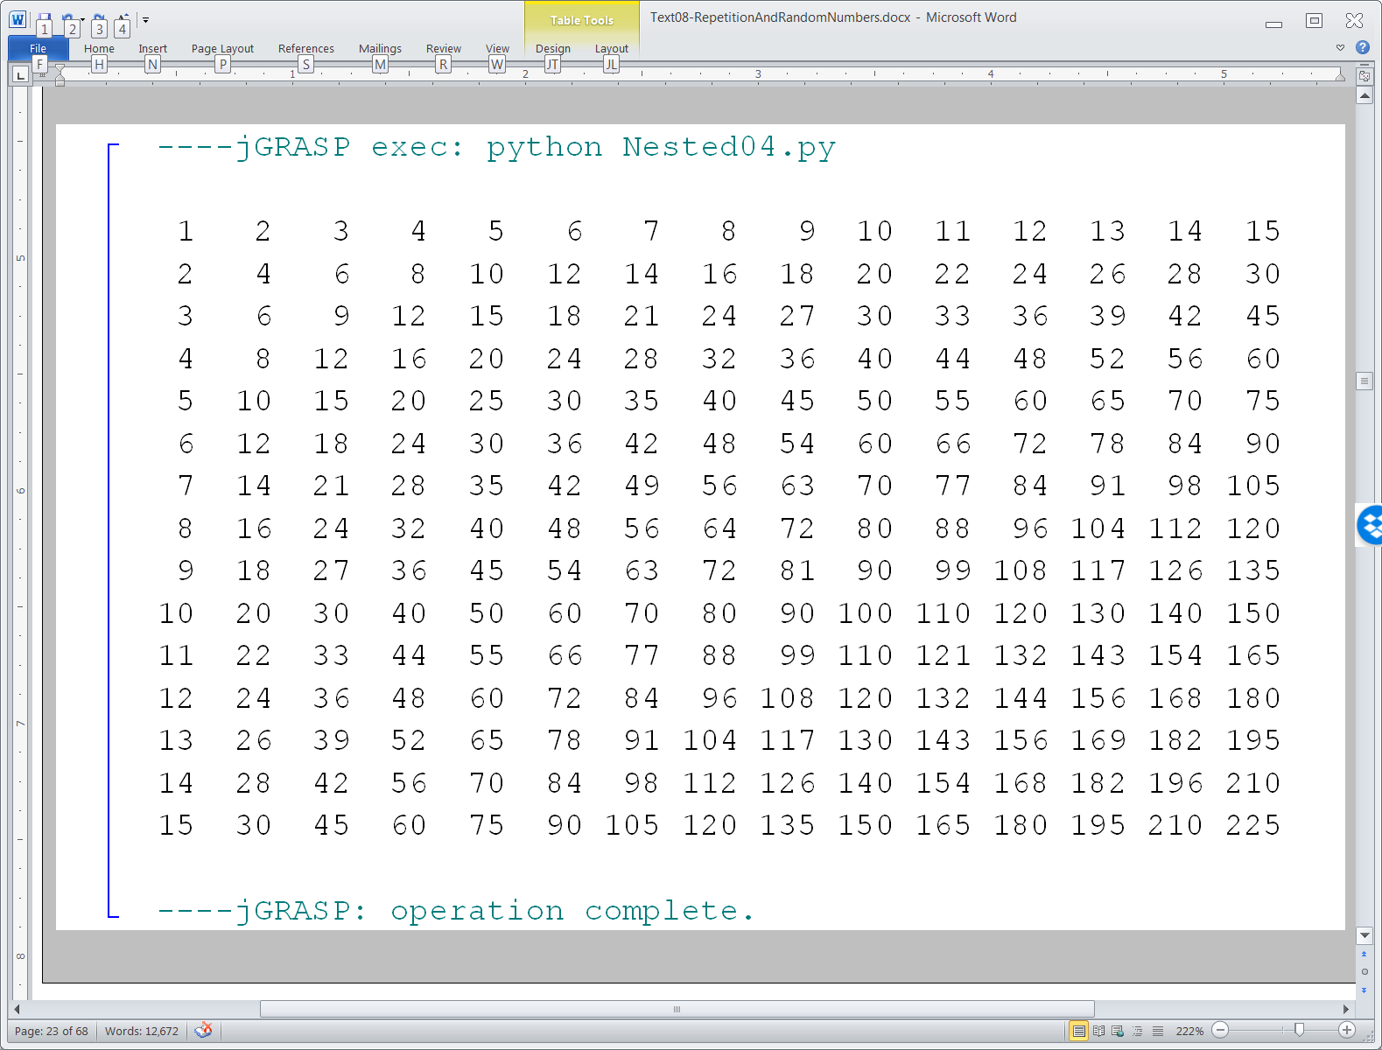

Slide 39
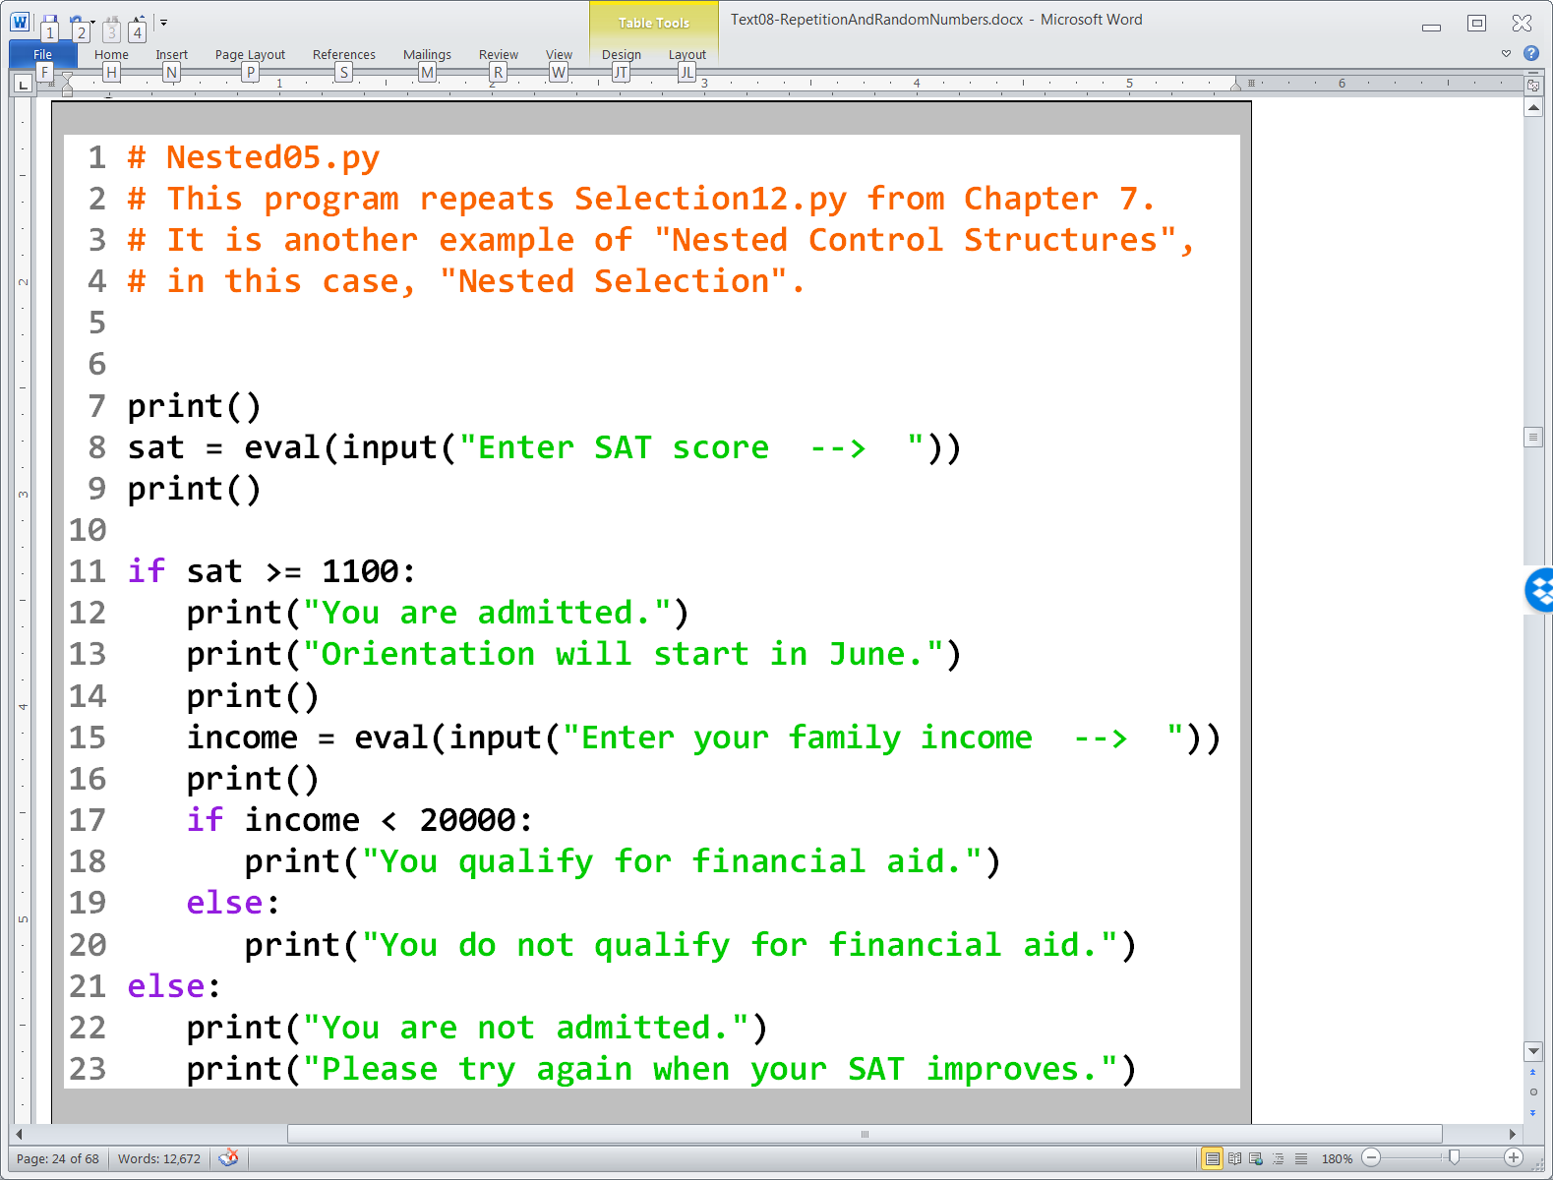

Slide 40
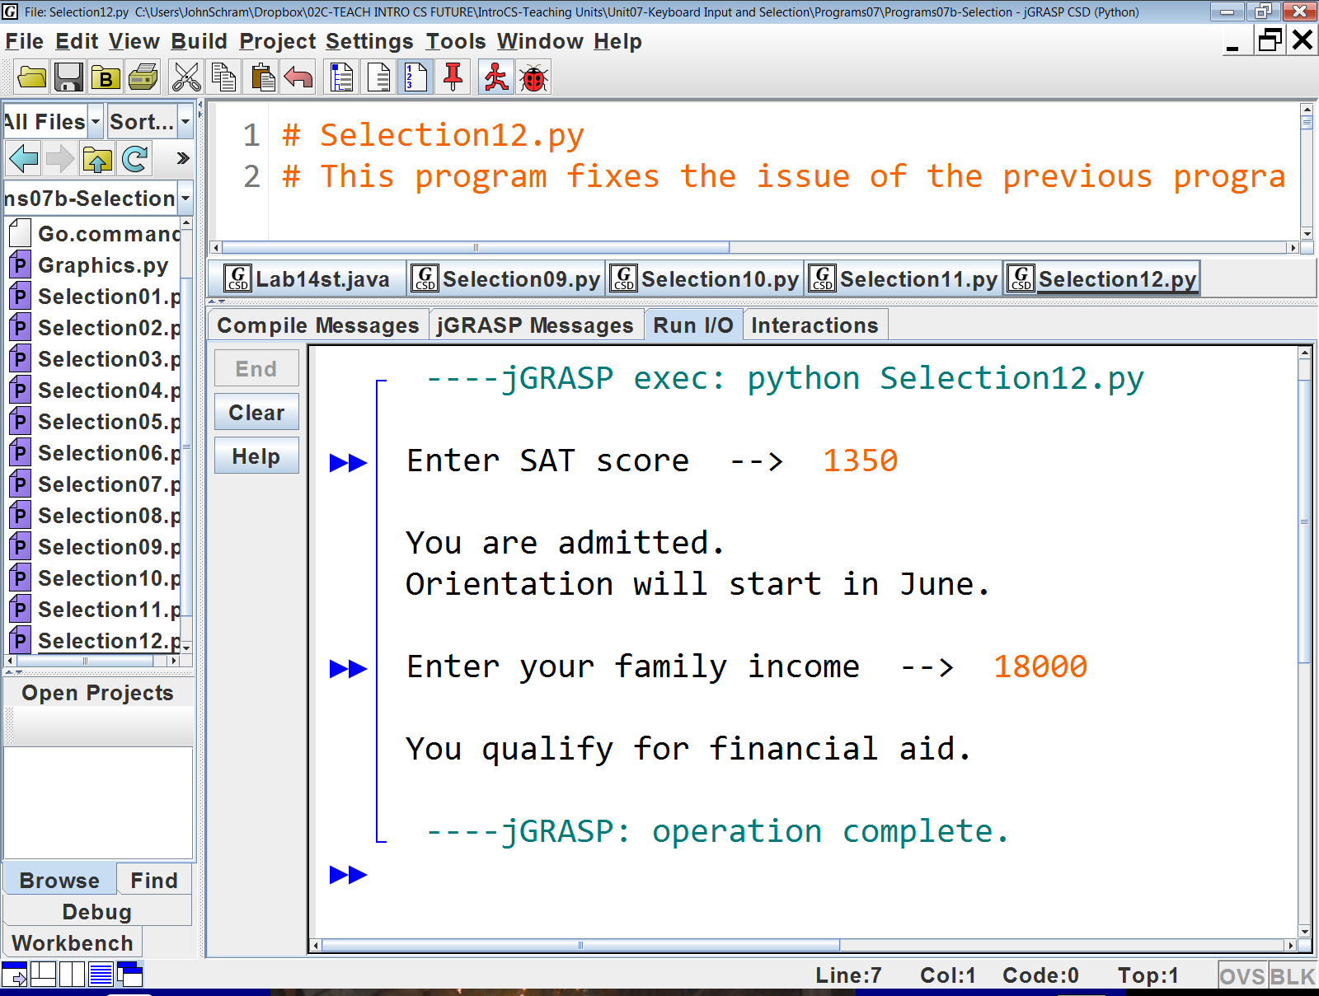
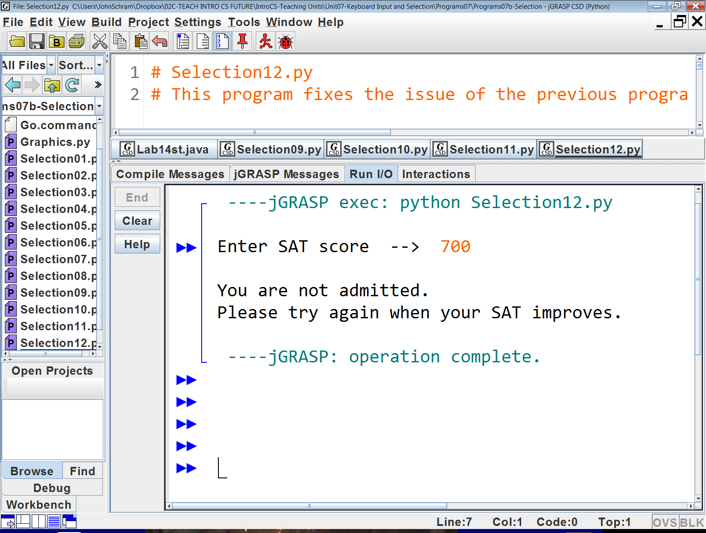
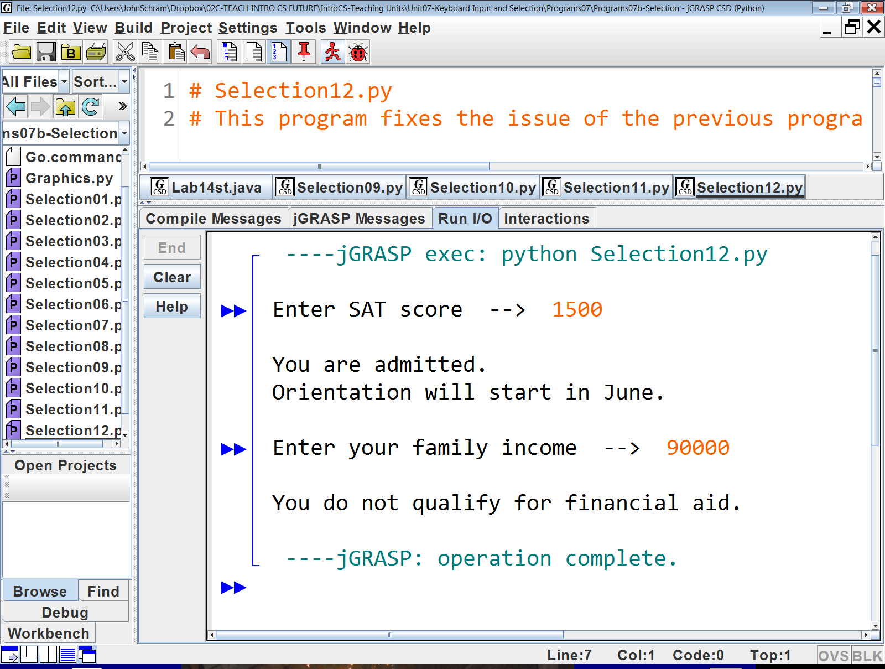

Slide 41
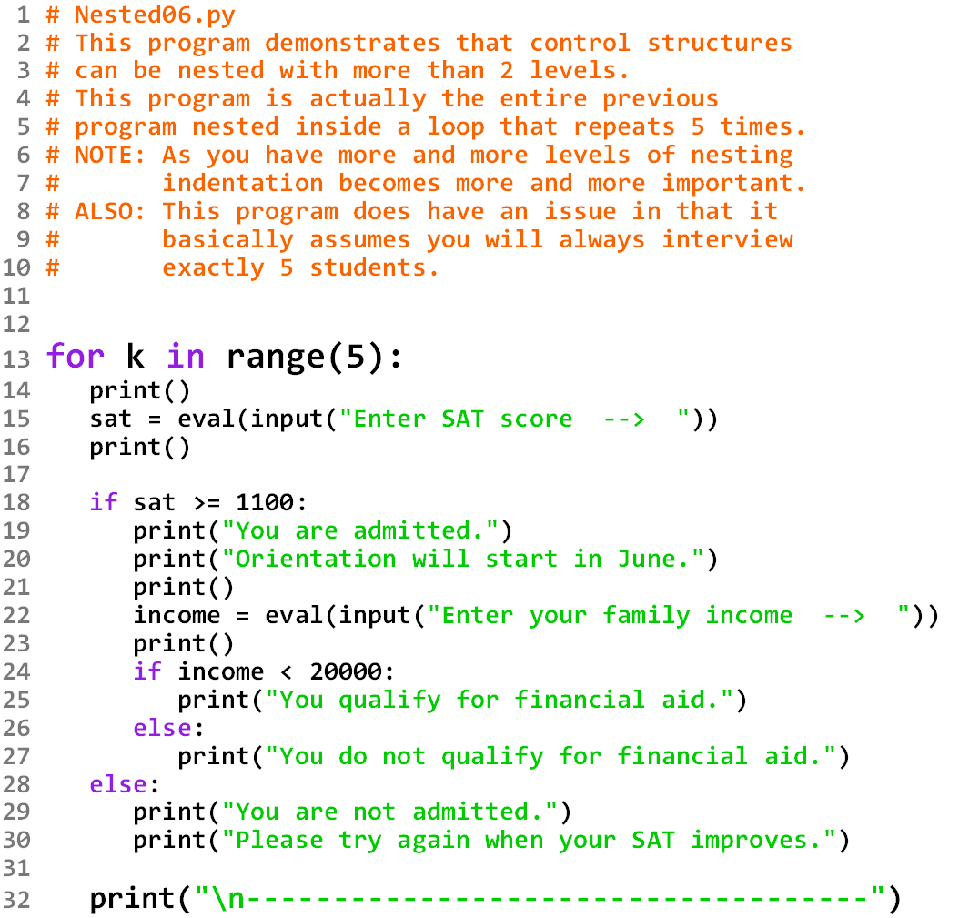

Slide 42
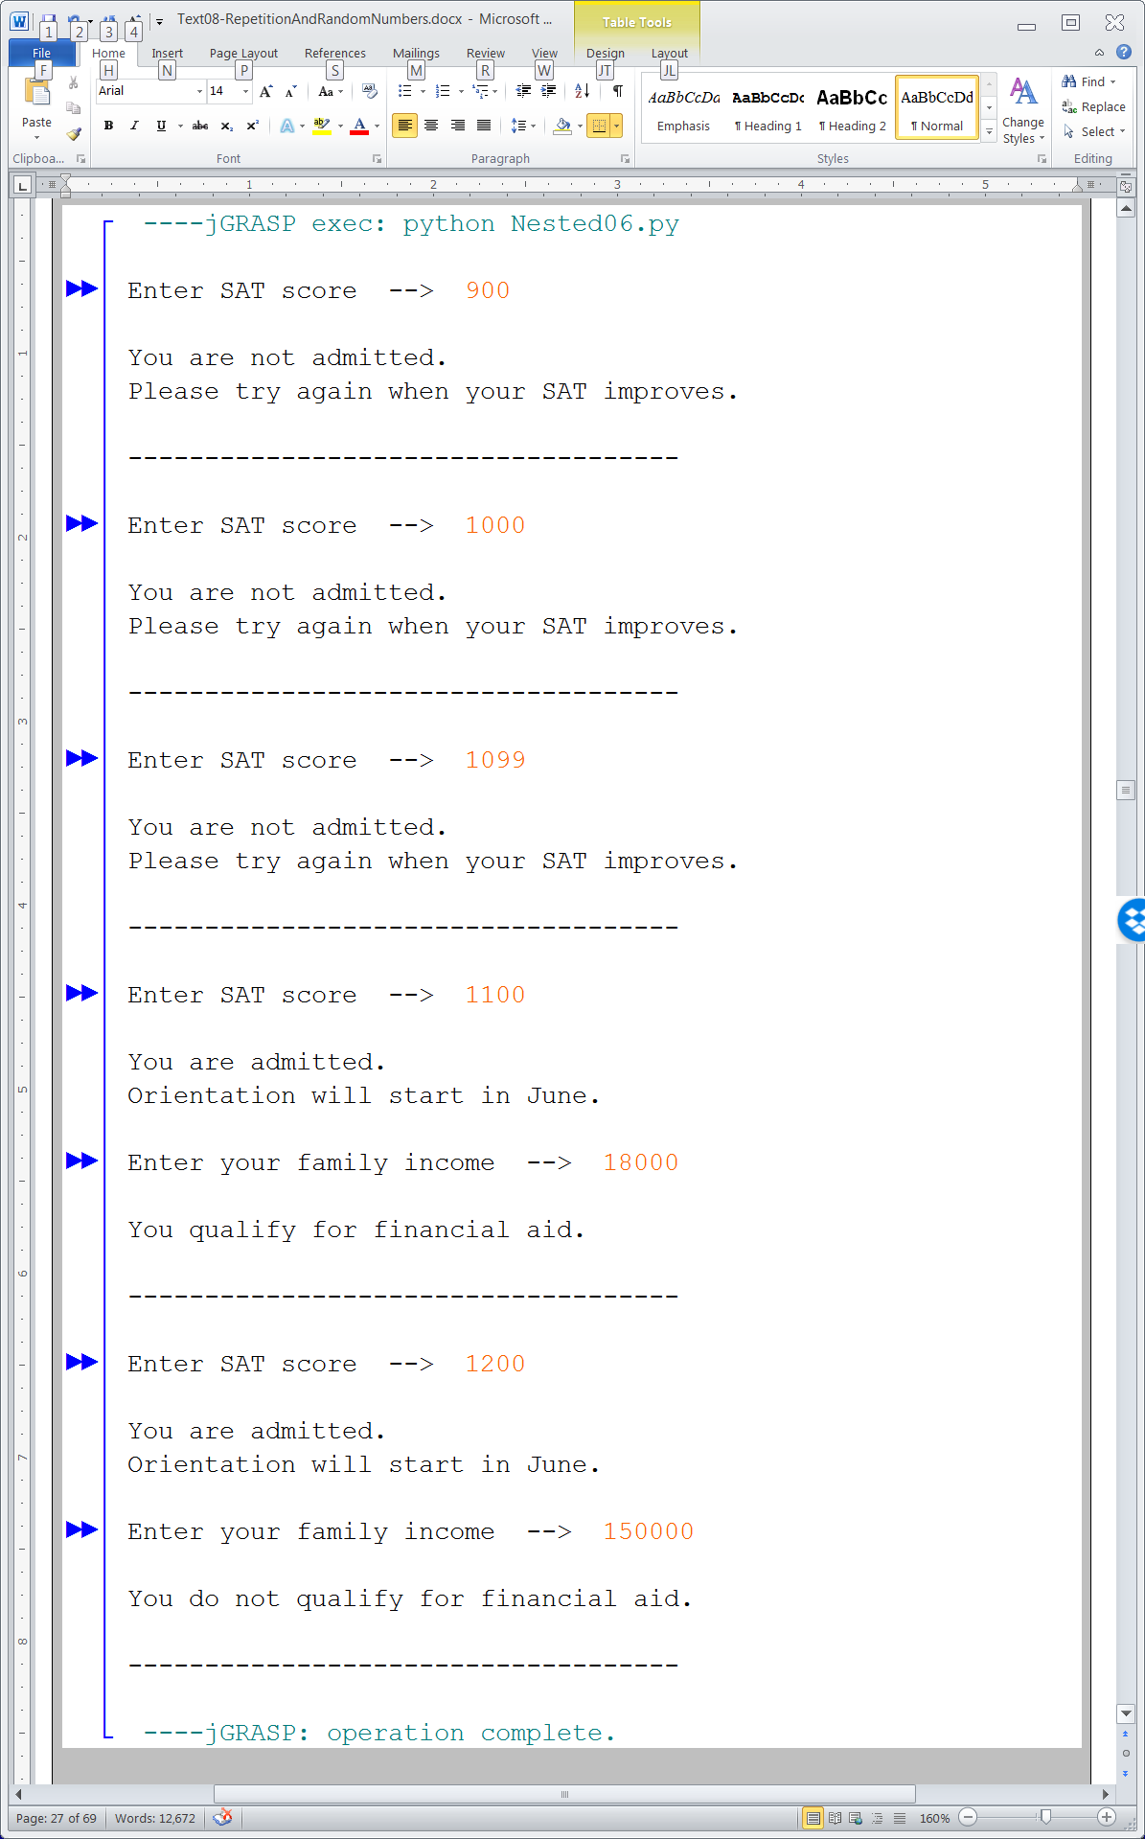

Slide 43
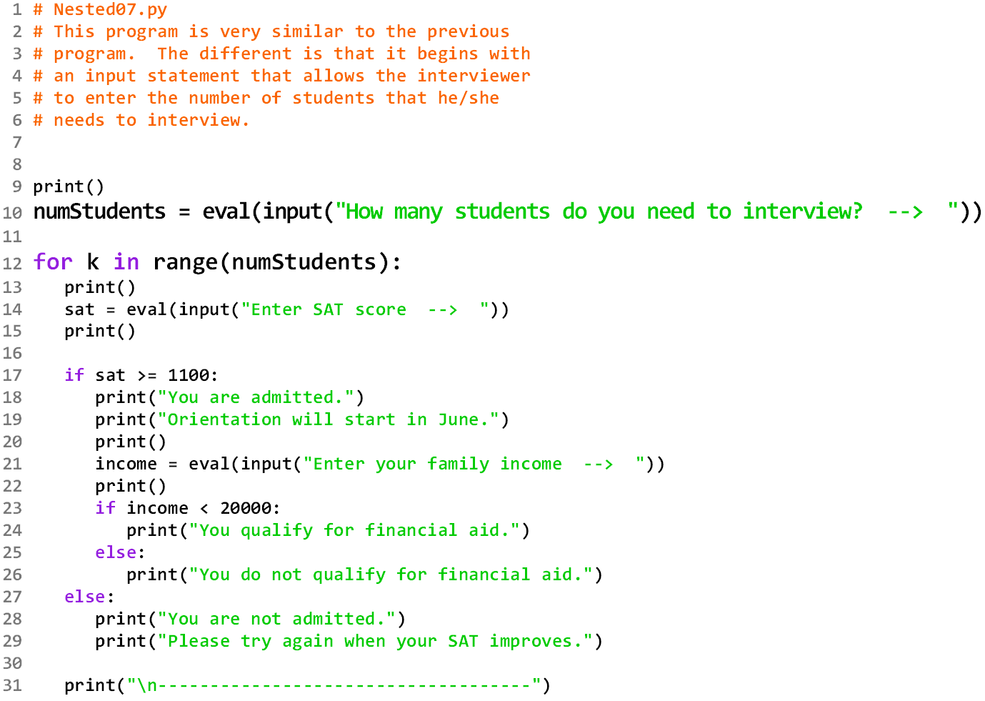

Slide 44
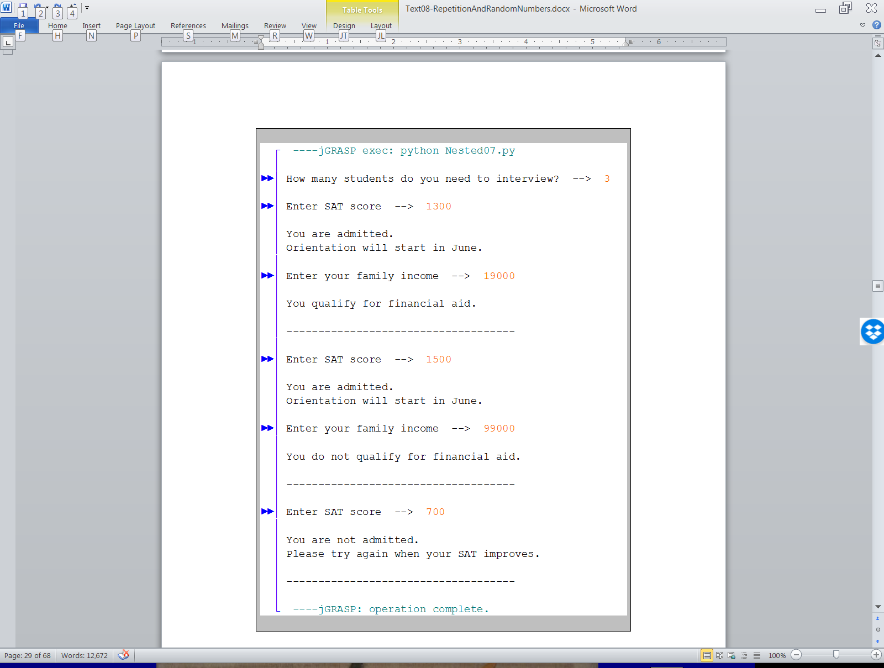

Slide 45
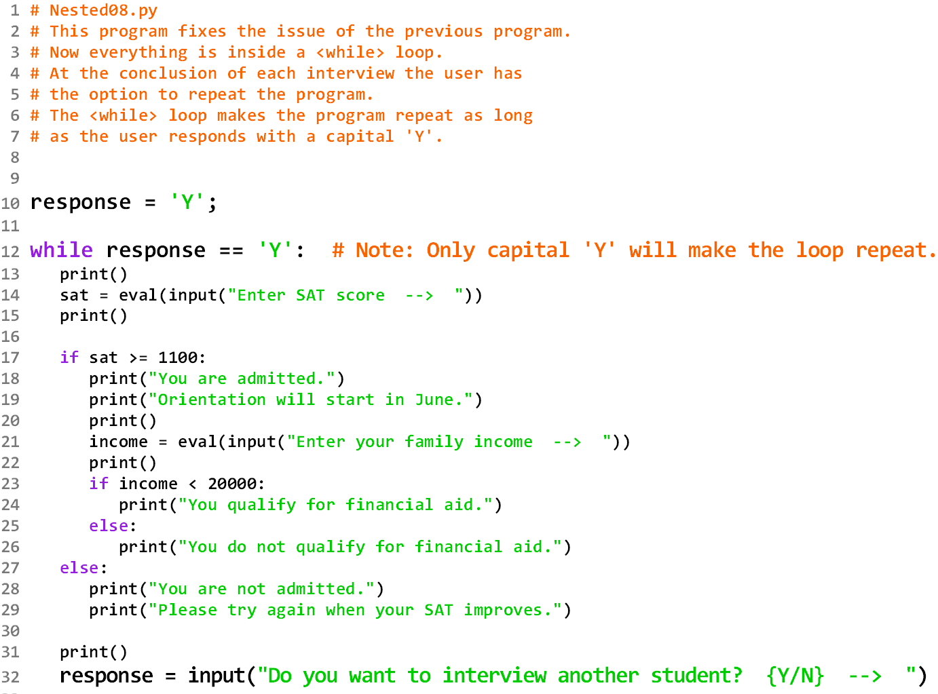

Slide 46
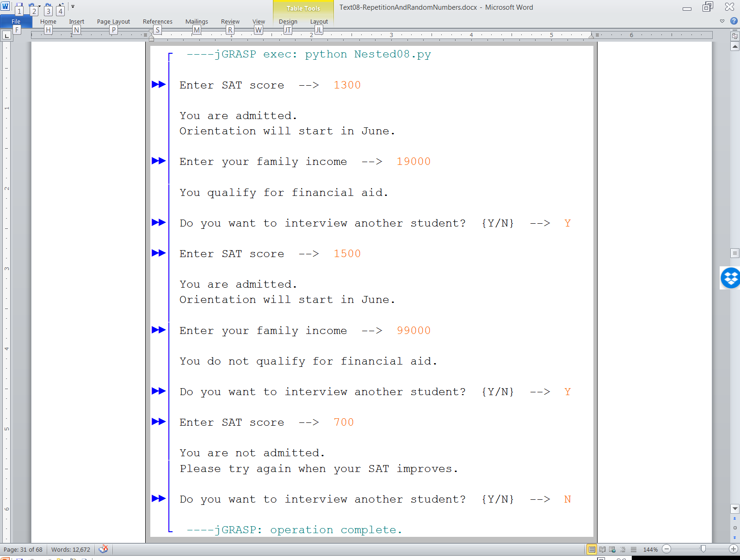

Slide 47
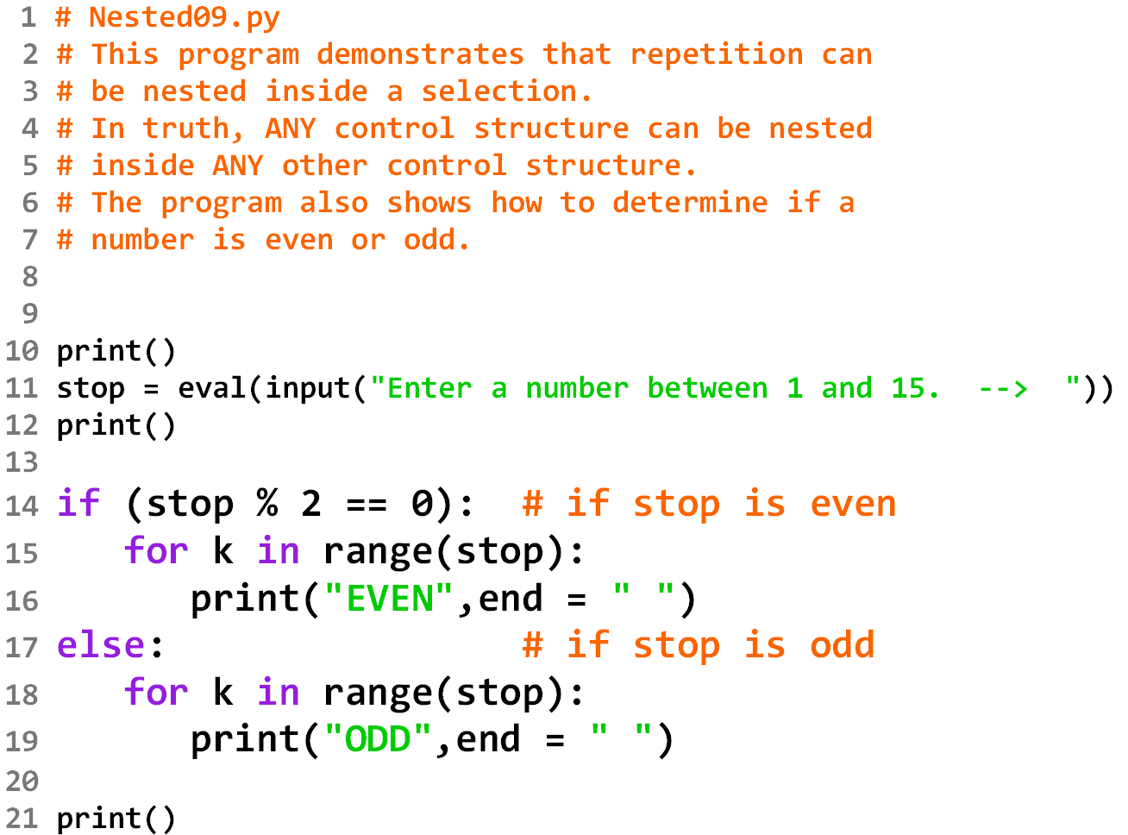

Slide 48
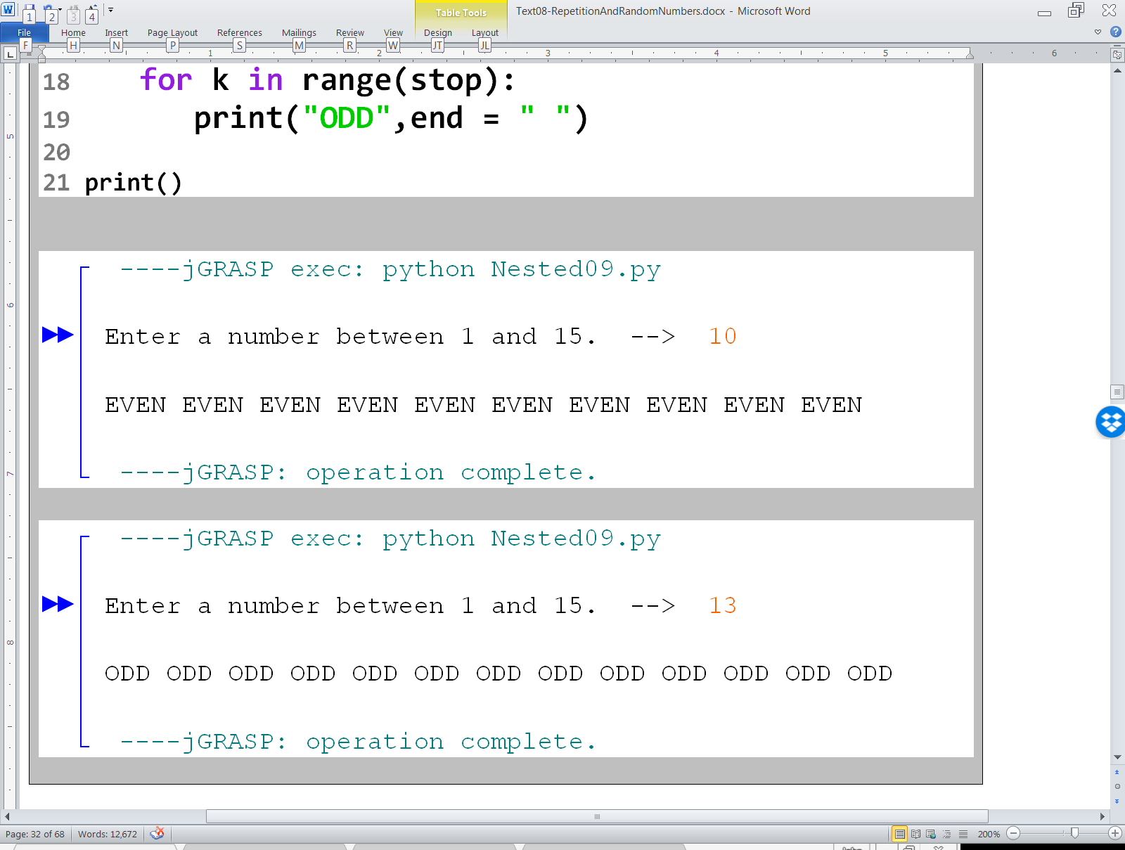

Slide 50
Section 8.5
Using Repetition
with Turtle Graphics

Slide 51
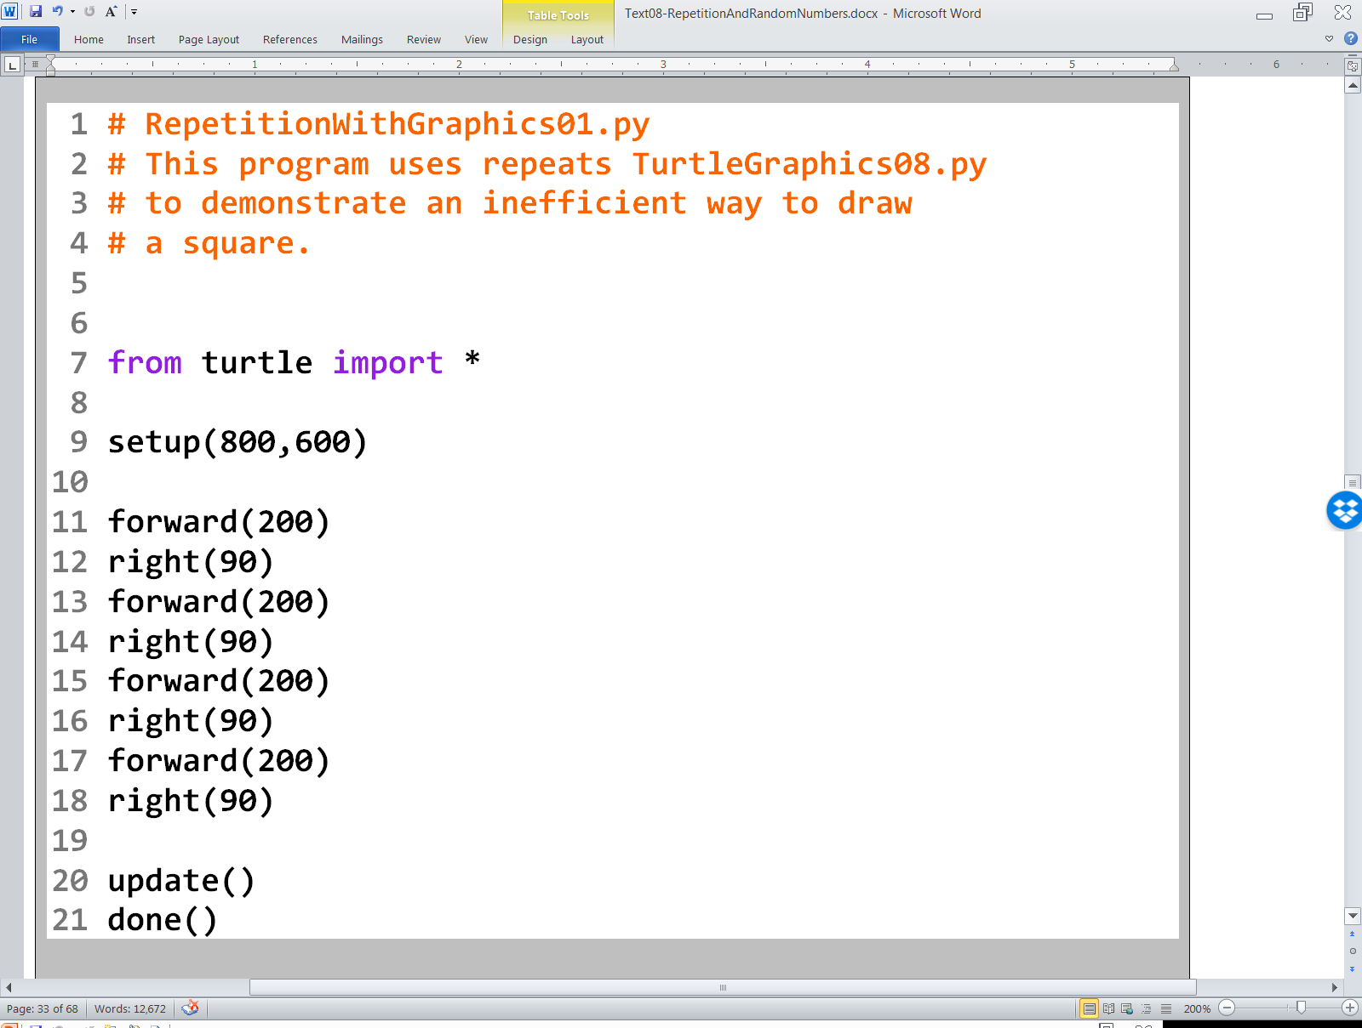


Slide 52


Slide 53


Slide 54


Slide 55

Lab 8A
What you saw in the last couple program examples relates directly to what you will be doing in Lab 8A.

